Slide 1
DEO Economic Development Planning Grants
Caroline Smith
ARPC Economic Development Manager
(850) 488-6211 ext. 108
CSmith@arpc.org

Slide 2
DEO PLANNING GRANTS
Grant Opportunities from FL Department of Economic Opportunity (DEO)
Community Planning Technical Assistance (CPTA) Grant
Competitive Florida Partnership Grant
Rural Infrastructure Fund (RIF) Planning Grant

Slide 3
DEO PLANNING GRANTS
 | Purpose | Eligible Applicants | Match Required? | Grant Amount | Project Timeline | Recent Projects
Community Planning Technical Assistance (CPTA) Grant | Community planning activities (broad range allowed) | Municipalities, counties, RPCs | No | Varies, generally $10K to $50K | 1 year | Apalachee Online (Phase 1&2), Community Planning Toolkit, Chattahoochee Streetscapes
Competitive Florida Partnership Grant | Create economic development strategy | Municipalities, counties, RPCs | No | $35K | 1 year | Recent recipients: Sopchoppy Panacea Midway Eastpoint Carrabelle Campbellton
Rural Infrastructure Fund (RIF) Planning Grant | Infrastructure and other economic development planning | Municipalities, counties | No | Up to $300K | 2 years | Town Center Redevelopment Plan for Campbellton

Slide 4
SAMPLE PROJECTS FROM EACH DEO GRANT
Community Planning Technical Assistance (CPTA) Grant:
Apalachee Online, Phase 1 and 2
Competitive Florida Partnership Grant:
Competitive Florida - Carrabelle
Rural Infrastructure Fund (RIF) Planning Grant:
Campbellton Town Center Redevelopment Plan

Slide 5
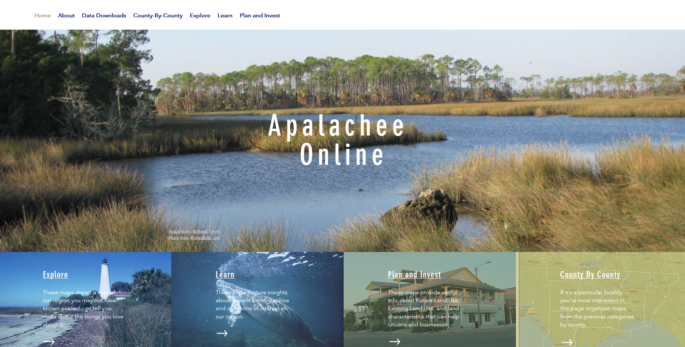
CPTA GRANT – APALACHEE ONLINE, PHASE 1 AND PHASE 2
Community Planning Technical Assistance (CPTA) Grant:
Apalachee Online
Applicant: ARPC
Purpose: Digitize city and county planning maps and house all geographic data on a single, interactive, easy-to-use website.
Project Cost: ~$65,000/phase
Phase 1: FY 2018-2019
Phase 2: FY 2019-2020
Homepage on Apalachee Online website

Slide 6
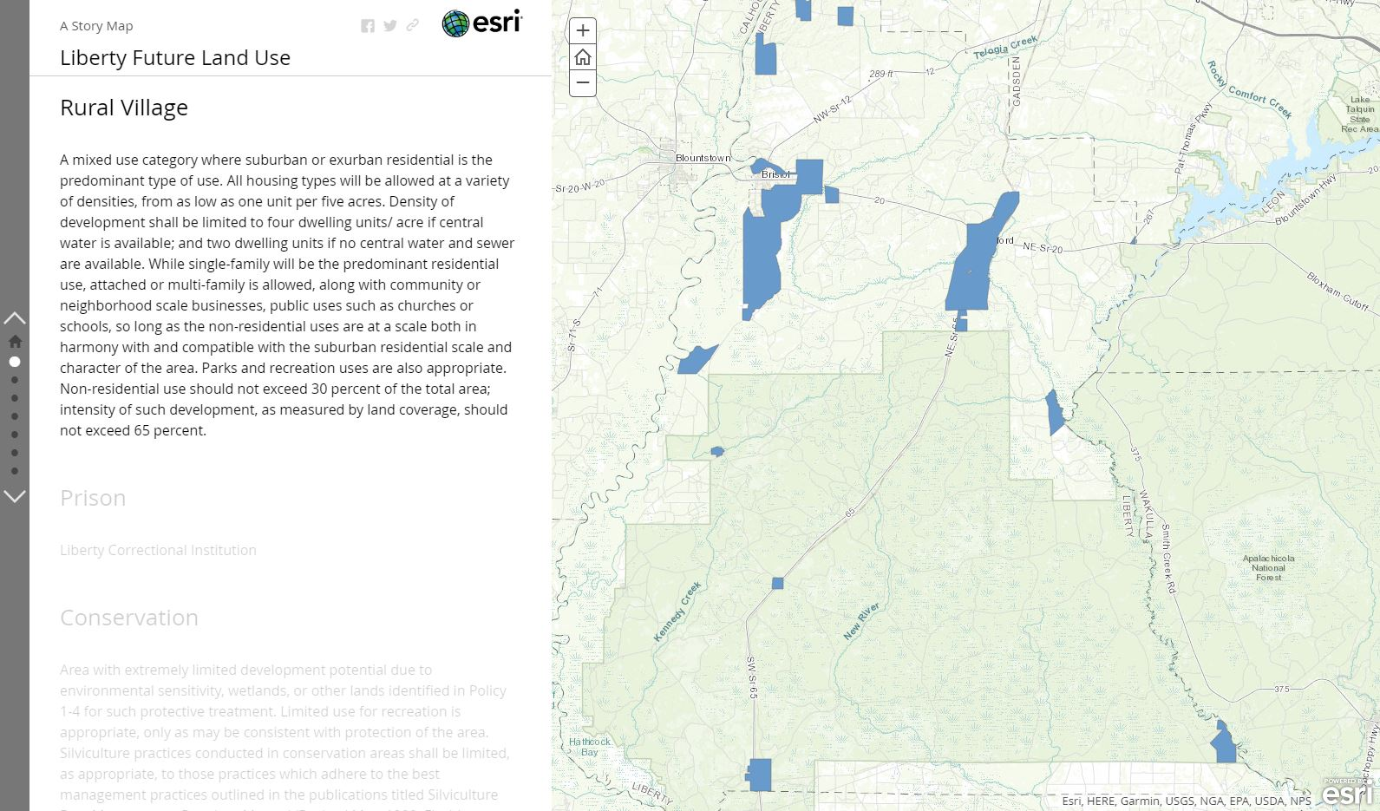
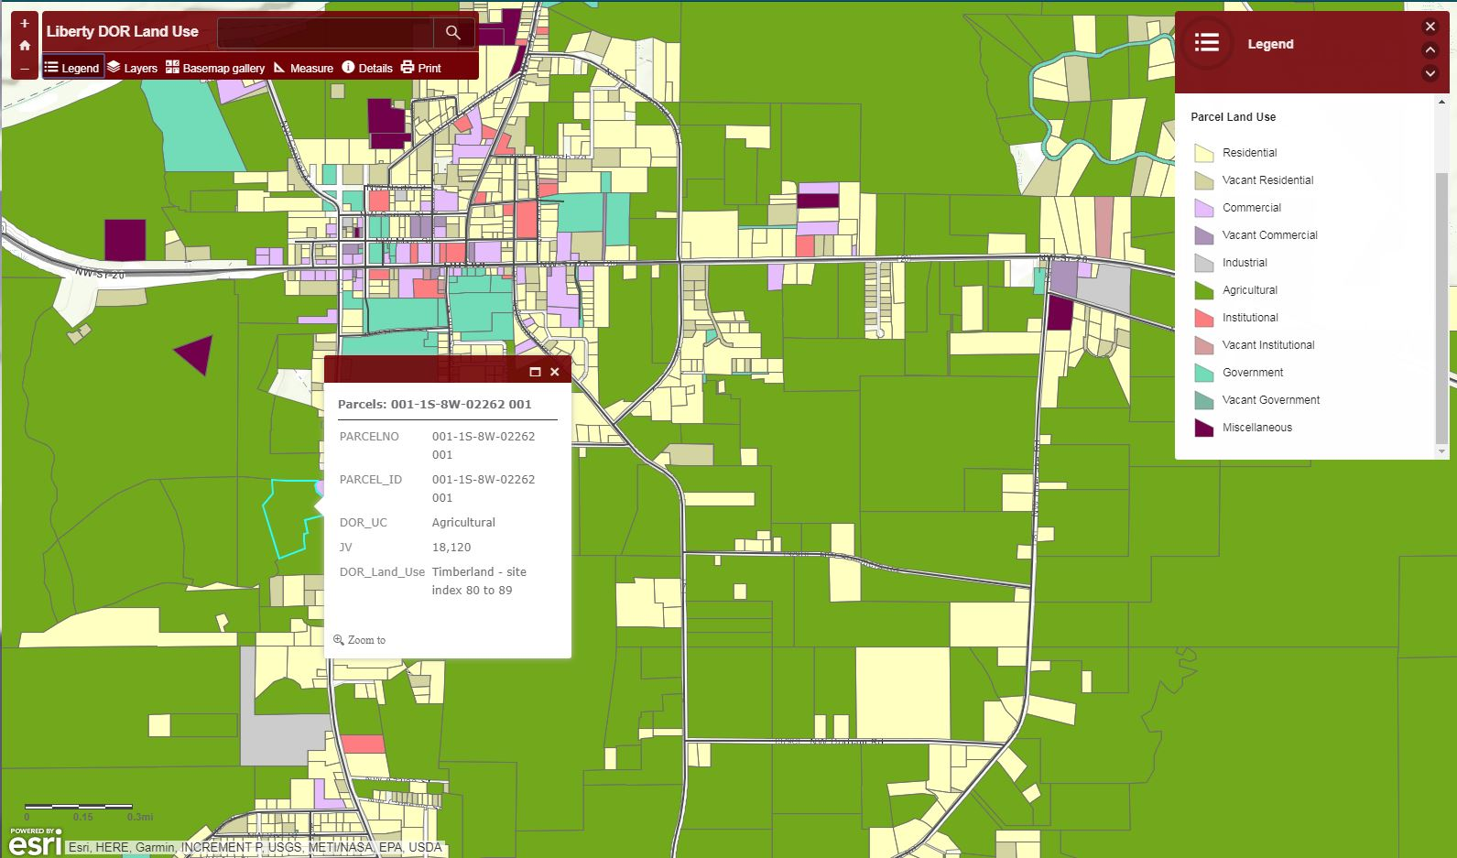
CPTA GRANT – APALACHEE ONLINE, PHASE 1 AND PHASE 2
Liberty County future land use map on Apalachee Online
Liberty County Department of Revenue (DOR) map on Apalachee Online

Slide 7
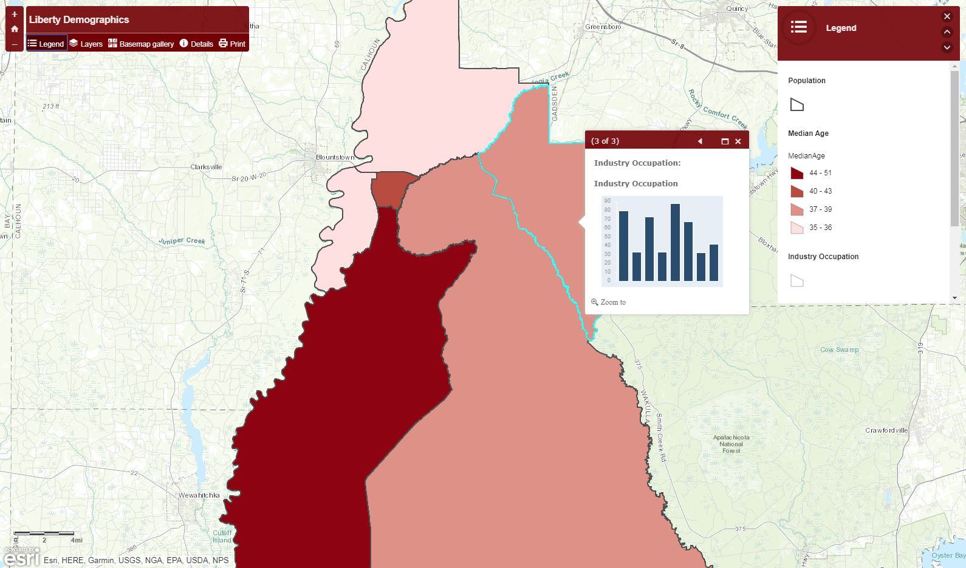
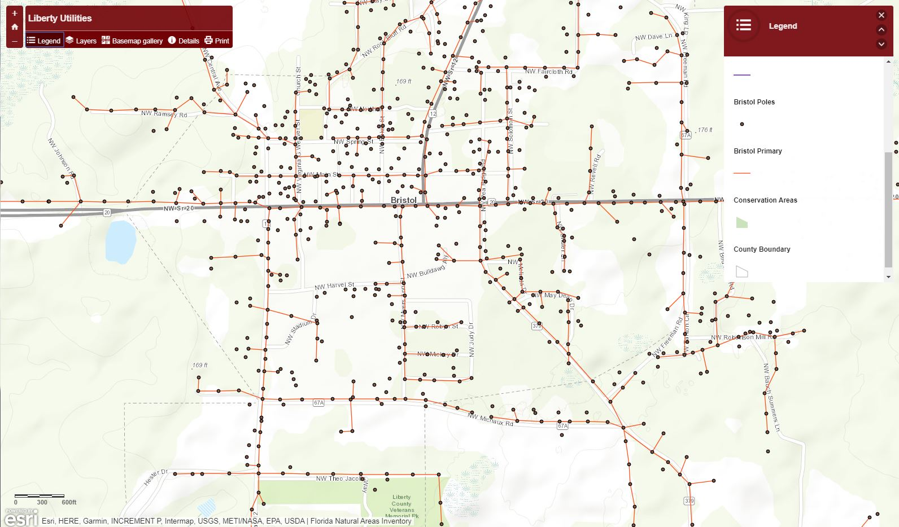
CPTA GRANT – APALACHEE ONLINE, PHASE 1 AND PHASE 2
Liberty County demographic map on Apalachee Online
Liberty County utilities map on Apalachee Online

Slide 8
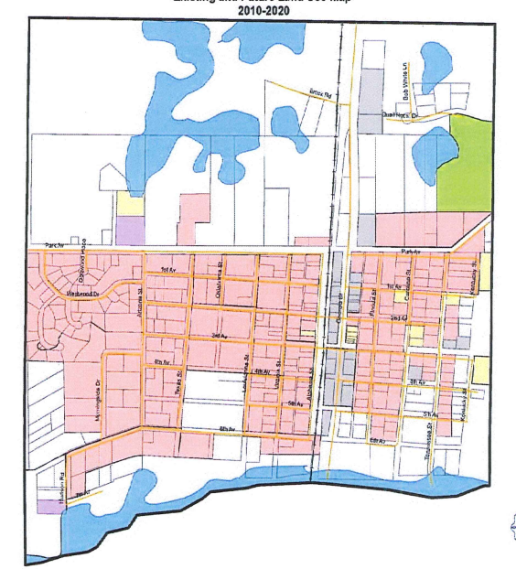
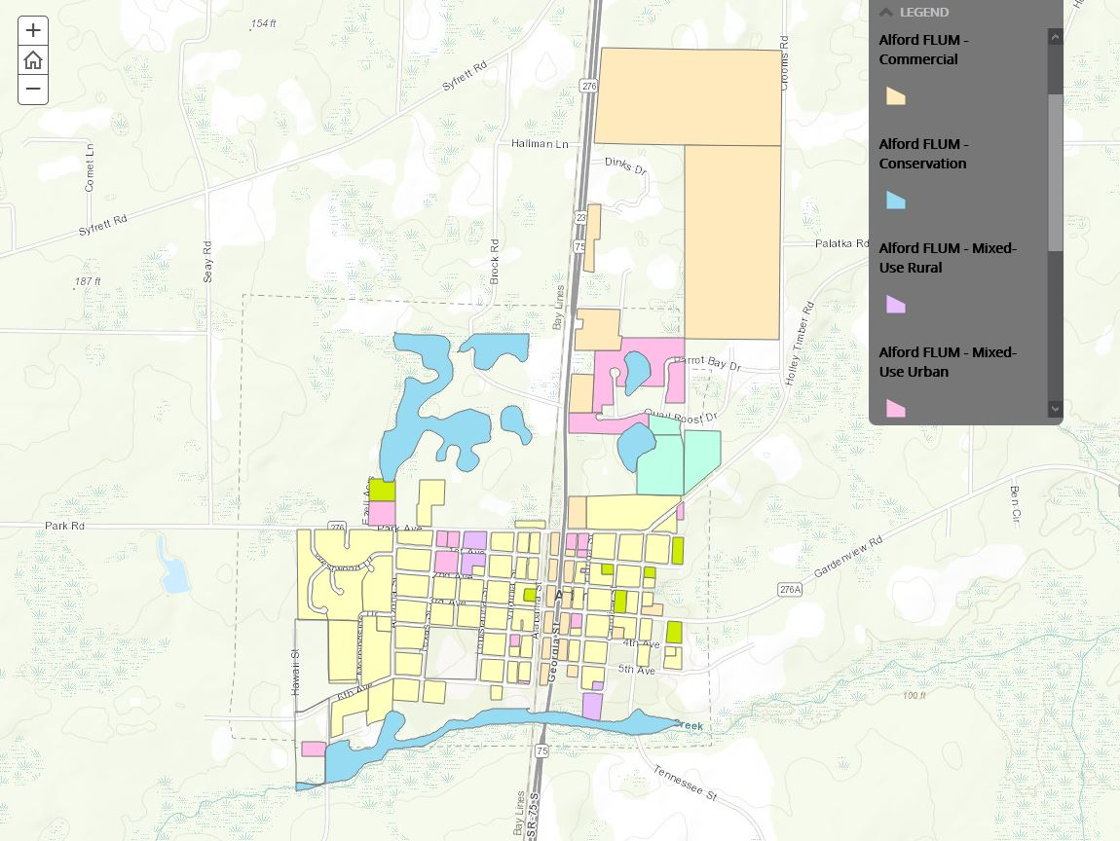
CPTA GRANT – APALACHEE ONLINE, PHASE 1 AND PHASE 2
Post-Project: Digitized version of Future Land Use Map for Town of Alford
Pre-Project: Original Future Land Use Map for Town of Alford
UP NEXT: COMPETITIVE FLORIDA

Slide 9
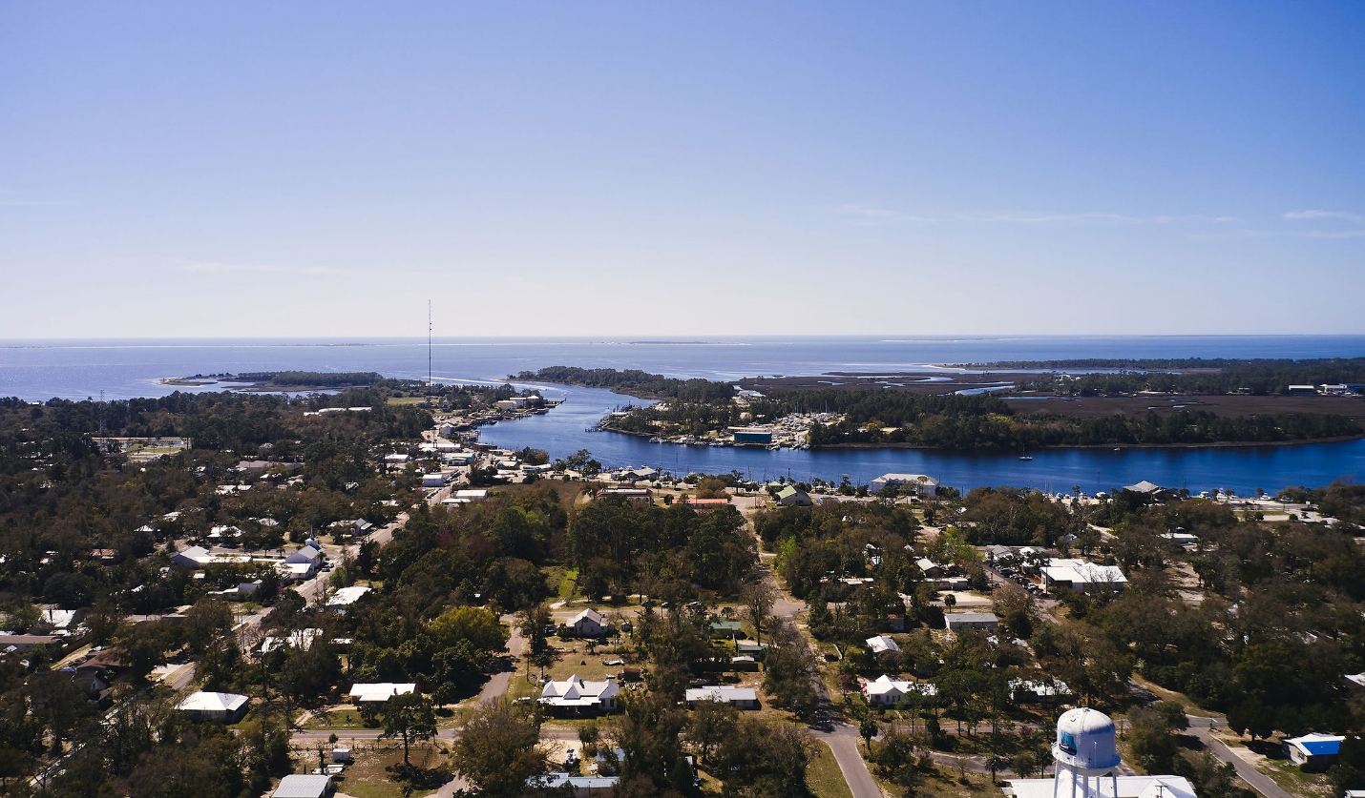
COMPETITIVE FLORIDA PARTNERSHIP GRANT - CARRABELLE
Competitive Florida Partnership Grant:
Competitive Florida - Carrabelle
Applicant: City of Carrabelle
Purpose: Create community-driven, asset-based Economic Development Strategy
Grant Activities:
Outreach
3 Public Workshops
Virtual Asset Mapping Exercise
Final Economic Development Strategy
Timeline: FY 2020-2021
Aerial view of Carrabelle in Franklin County

Slide 10
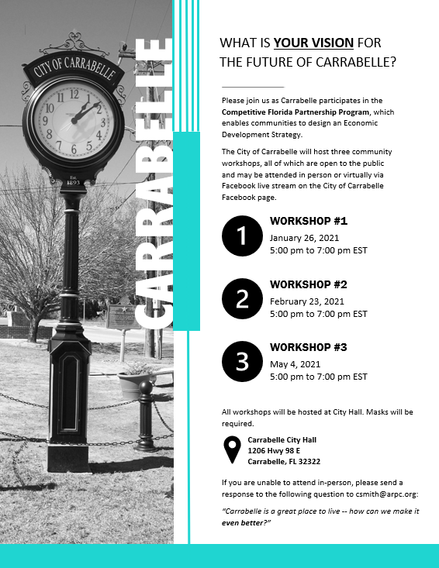
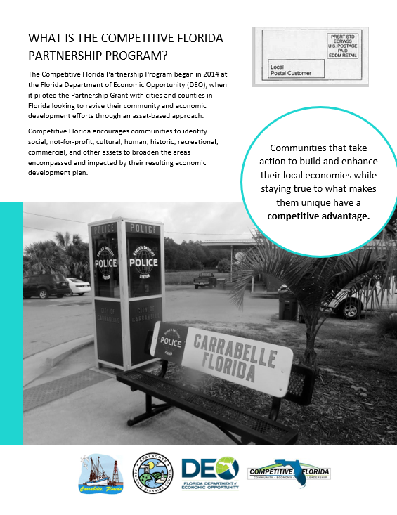
COMPETITIVE FLORIDA PARTNERSHIP GRANT - CARRABELLE
OUTREACH
Left: 1-page flyer (front/back) used for resident and business outreach in Carrabelle

Slide 11
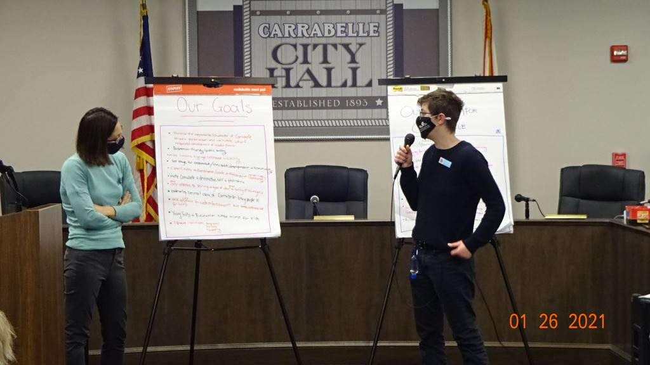
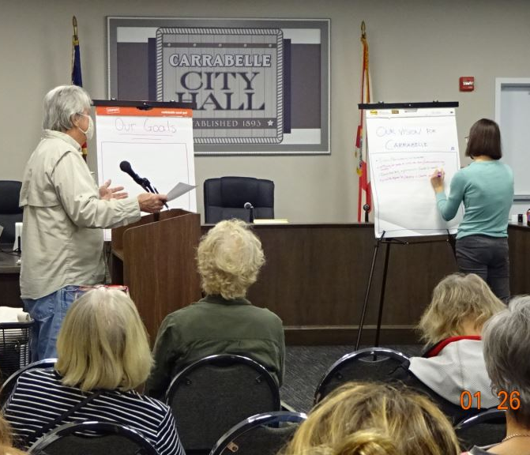
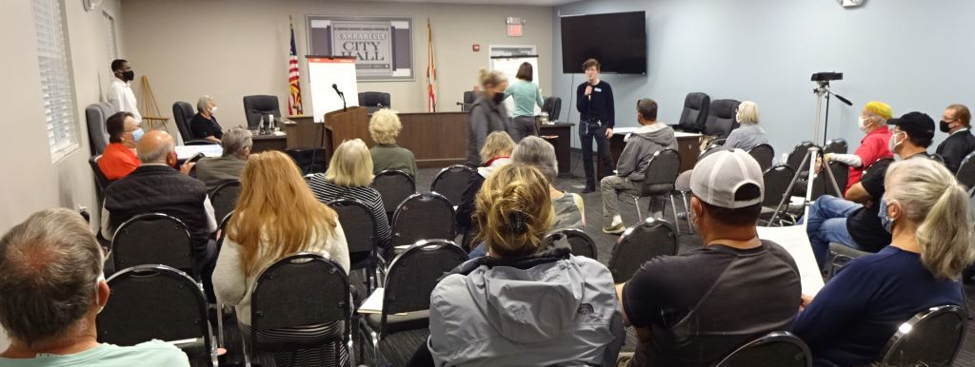
COMPETITIVE FLORIDA PARTNERSHIP GRANT - CARRABELLE
PUBLIC WORKSHOPS
Left: Images from first community workshop - held as part of Carrabelle’s Competitive Florida Partnership Grant
Workshop input serves as the foundation for the community’s Economic Development Strategy.
Workshops are interactive and include activities to efficiently and creatively generate input from community members.

Slide 12
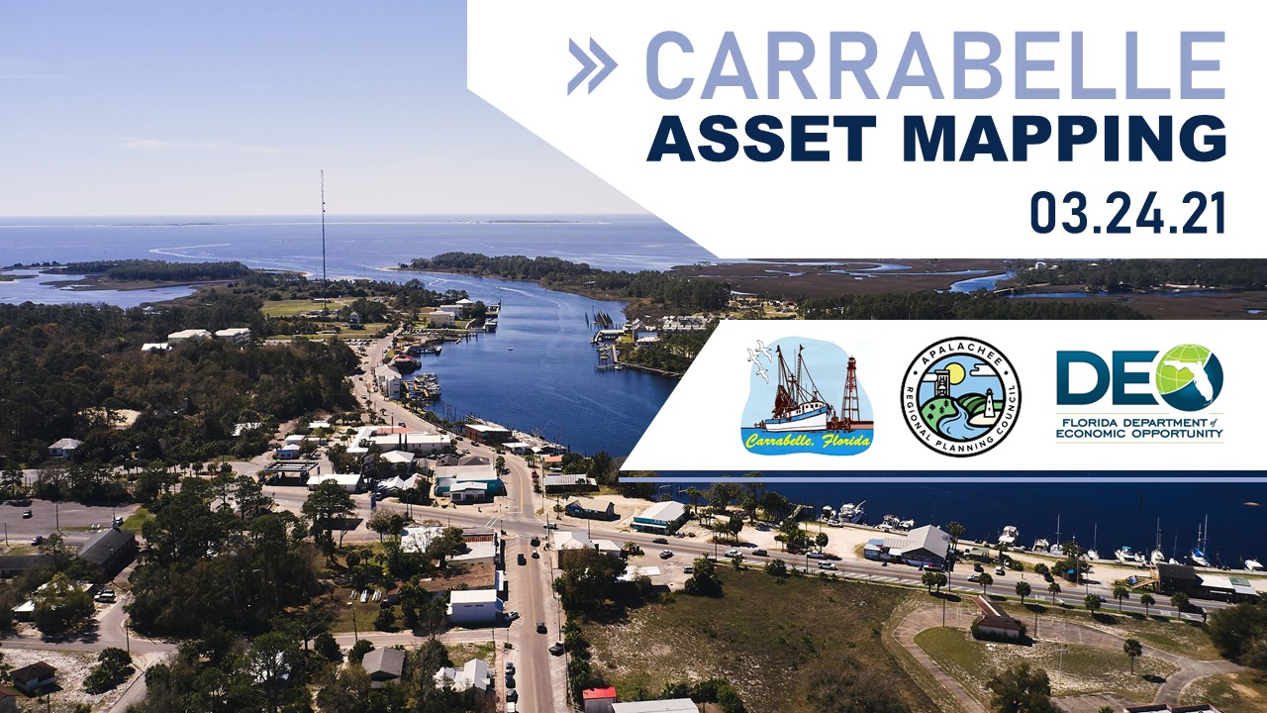
COMPETITIVE FLORIDA PARTNERSHIP GRANT - CARRABELLE
VIRTUAL ASSET MAPPING EXERCISE
Left: Opening image from Carrabelle’s Virtual Asset Mapping Exercise
Local, regional, state, and federal agency partners participate in a community-led tour of assets.
Participating agency partners provide feedback and ideas for harnessing the assets to enhance local economic development.

Slide 13
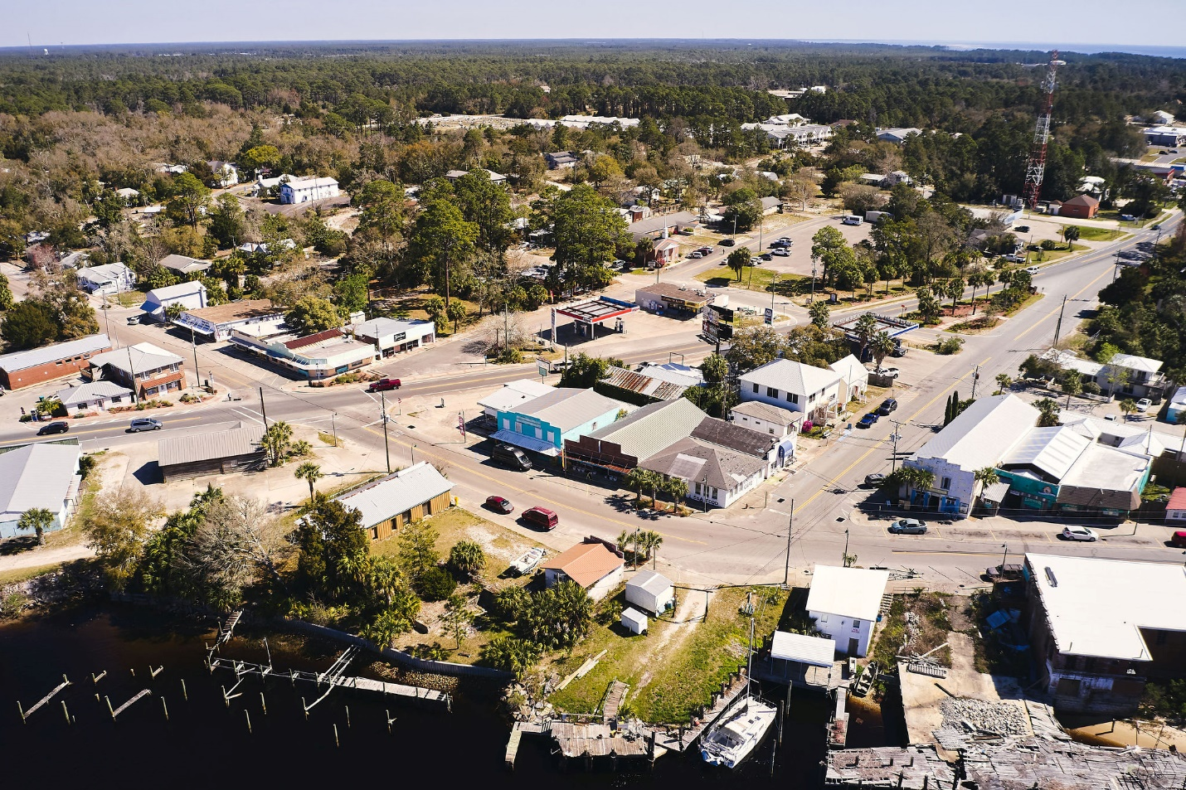
COMPETITIVE FLORIDA PARTNERSHIP GRANT - CARRABELLE
VIRTUAL ASSET MAPPING EXERCISE
Aerial photographs taken of specific points in Carrabelle using drone technology –
Left: Downtown Carrabelle

Slide 14
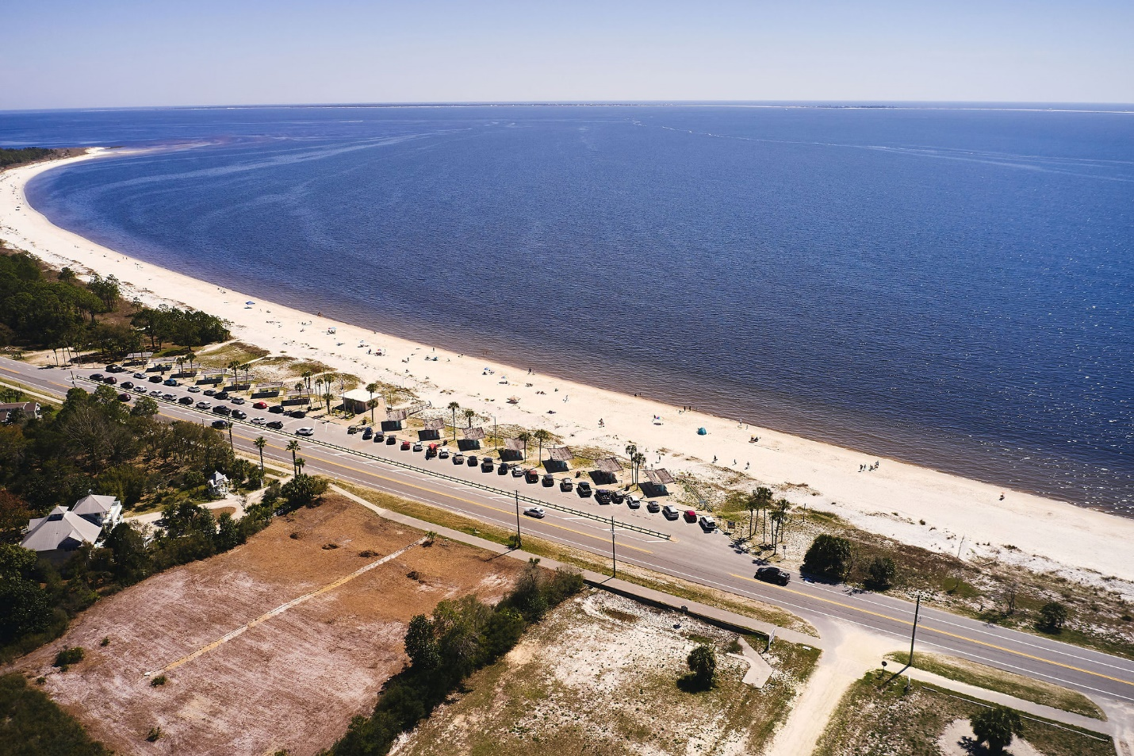
COMPETITIVE FLORIDA PARTNERSHIP GRANT - CARRABELLE
VIRTUAL ASSET MAPPING EXERCISE
Aerial photographs taken of specific points in Carrabelle using drone technology –
Left: Carrabelle Beach

Slide 15
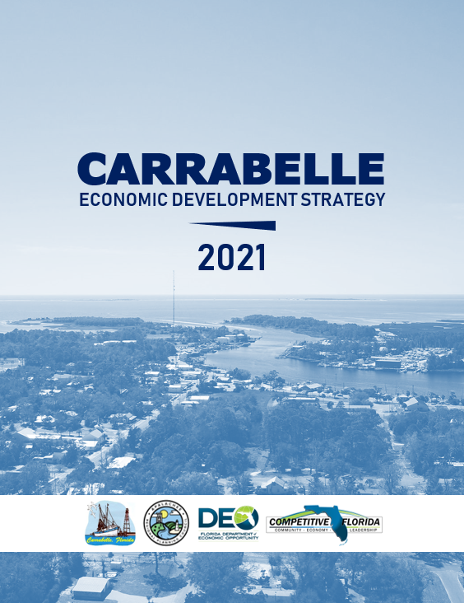
COMPETITIVE FLORIDA PARTNERSHIP GRANT - CARRABELLE
ECONOMIC DEVELOPMENT STRATEGY
Left: Cover page for Carrabelle’s draft Economic Development Strategy
APPLICATIONS DUE MAY 25, 2021
UP NEXT: RURAL INFRASTRUCTURE FUND

Slide 16
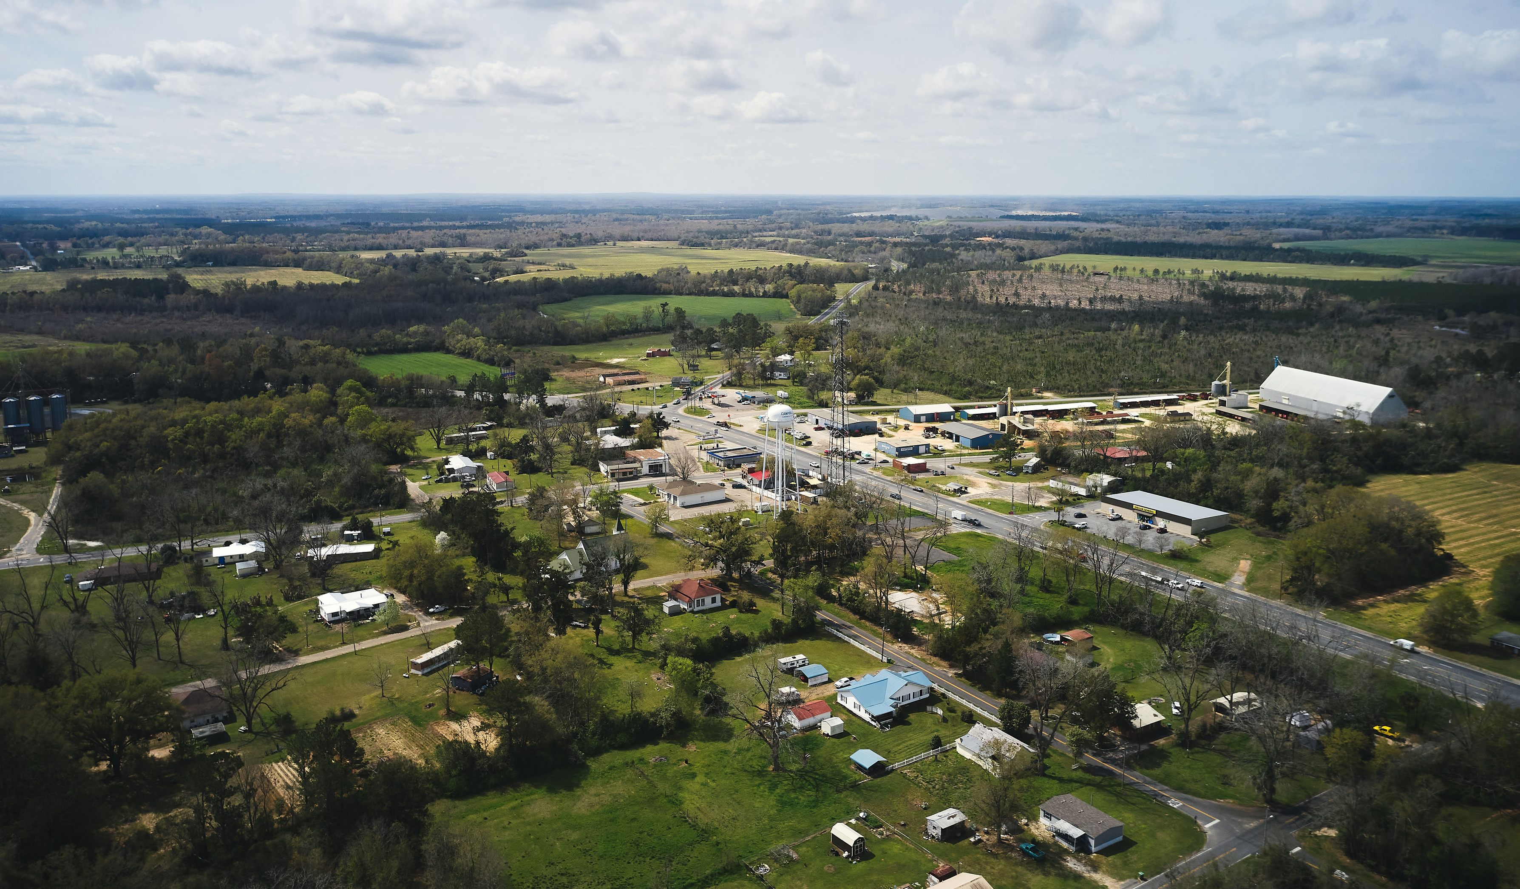
RIF PLANNING GRANT – CAMPBELLTON TOWN CENTER REDEVELOPMENT PLAN
Rural Infrastructure Fund (RIF) Planning Grant:
Campbellton Town Center Redevelopment Plan
Applicant: Town of Campbellton
Purpose: Create redevelopment plan for town center to increase investment, attract business, and support existing businesses like Southern Fields Brewing
Timeline: FY 2020-2022
Aerial view of Campbellton in Jackson County

Slide 17
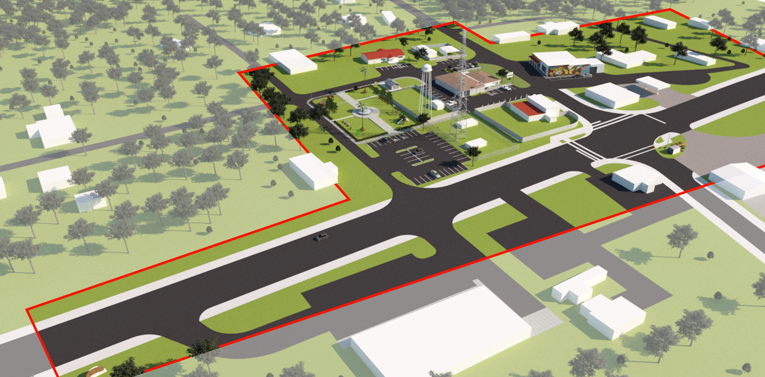
RIF PLANNING GRANT – CAMPBELLTON TOWN CENTER REDEVELOPMENT PLAN
Rural Infrastructure Fund (RIF) Planning Grant:
Campbellton Town Center Redevelopment Plan
Phase 1 – Concept Design
Phase 2 – Engineering
Project Cost: $70,000
Campbellton Town Center Redevelopment Plan

Slide 18
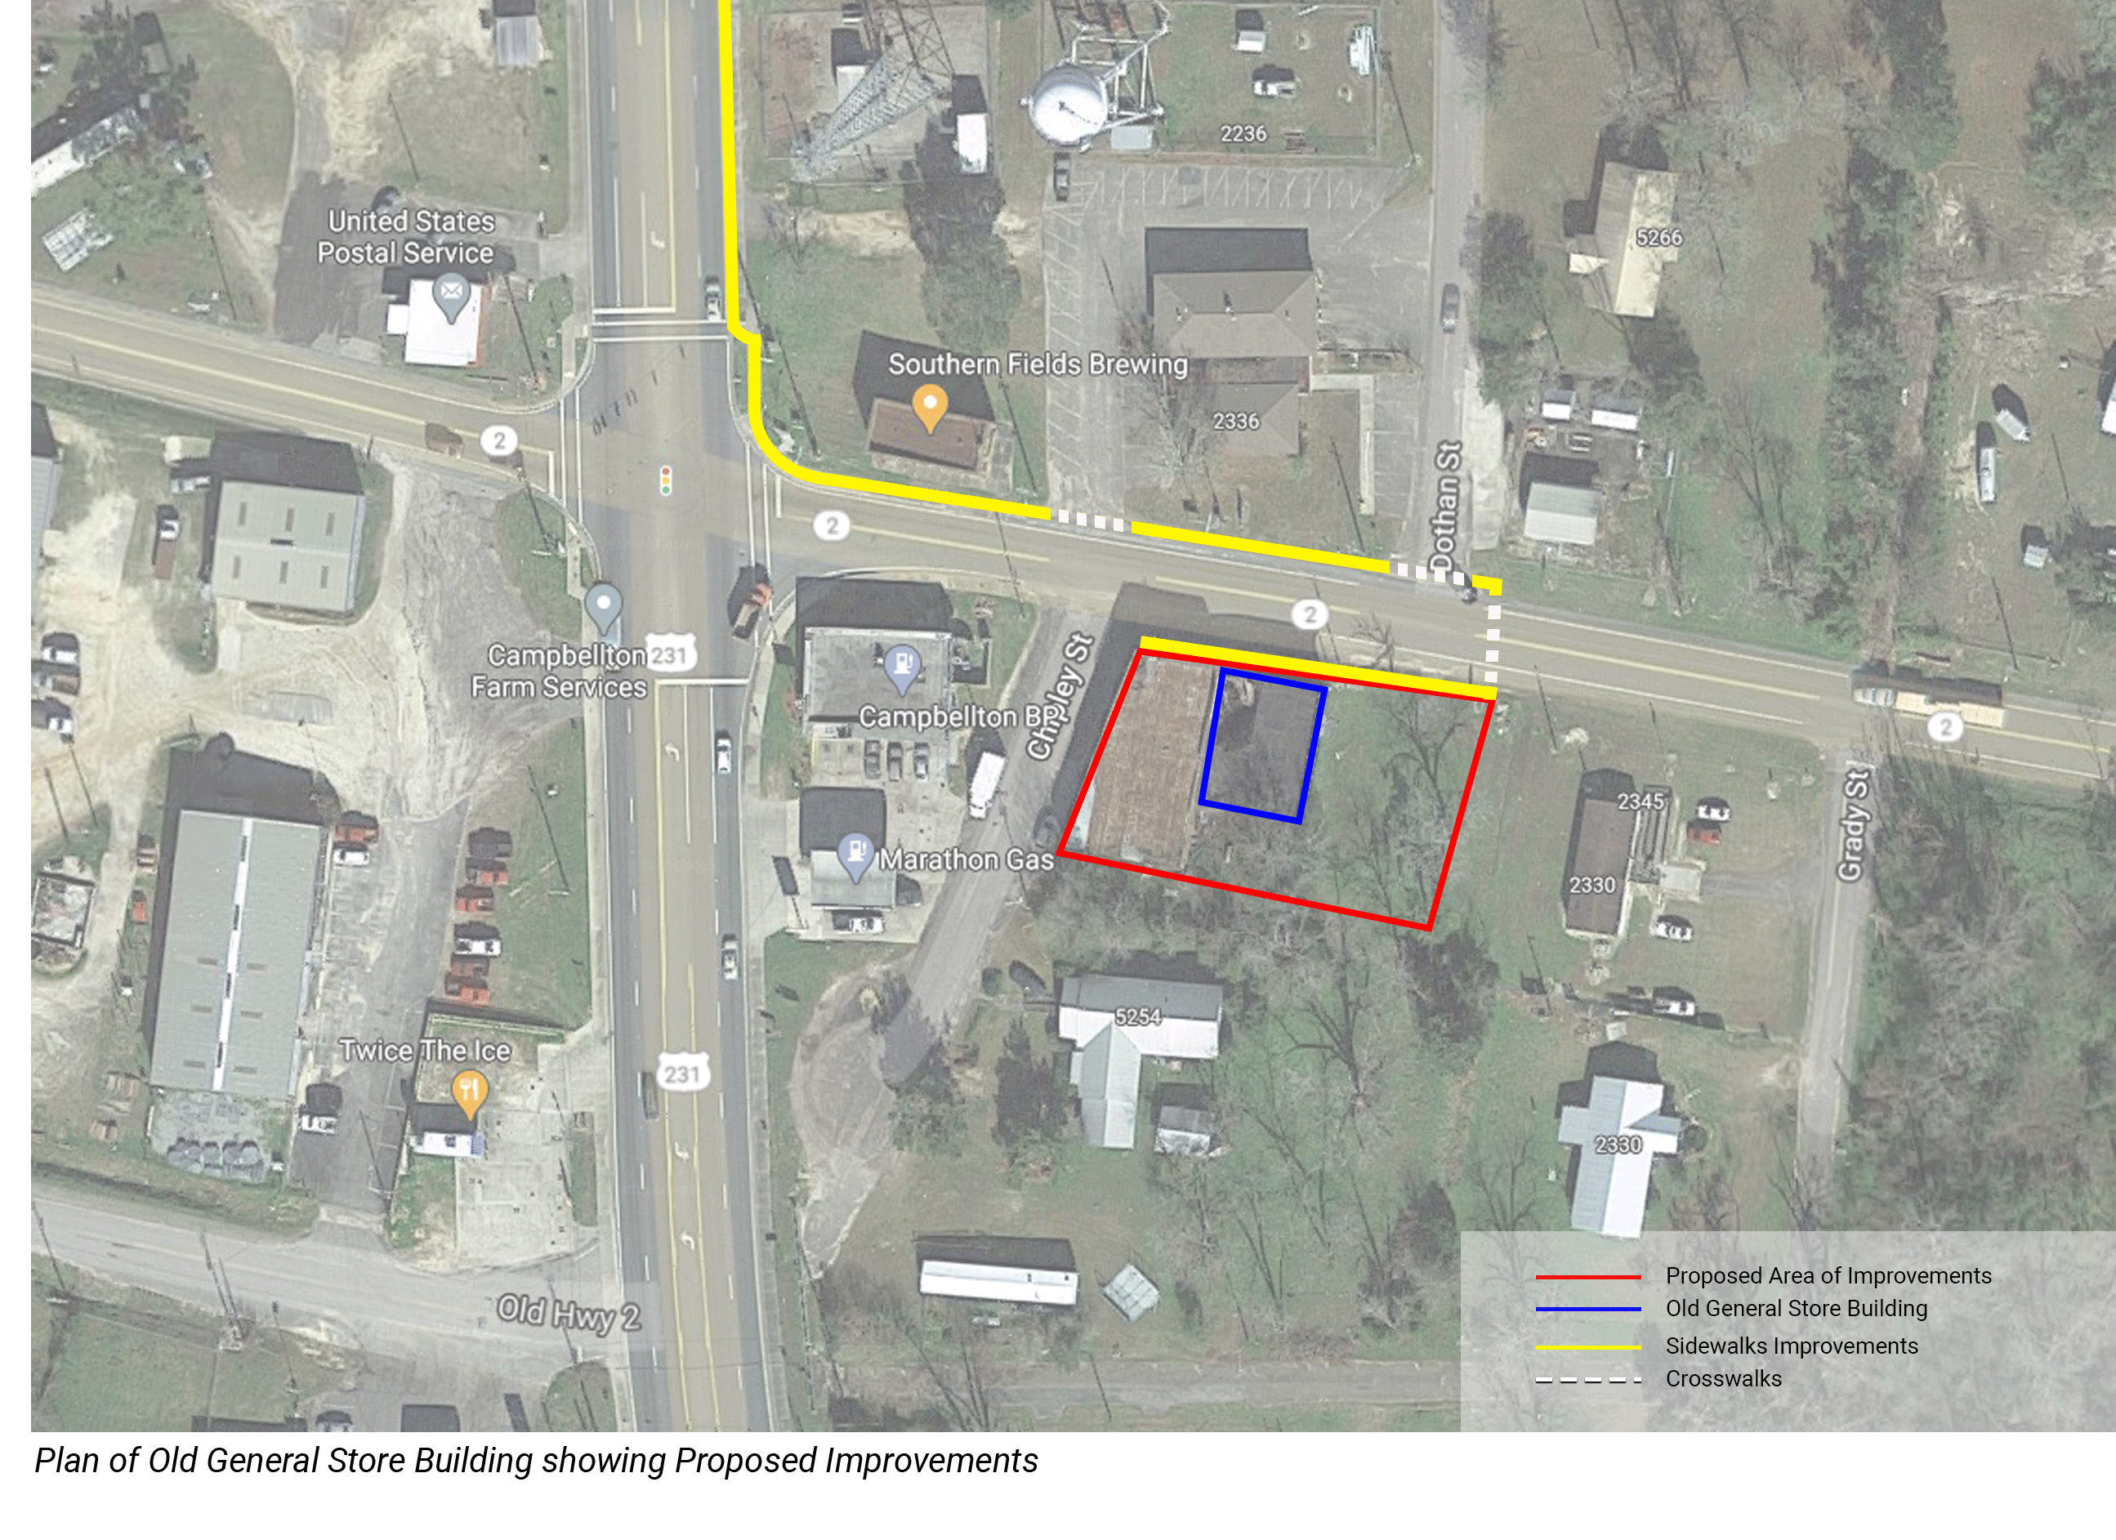
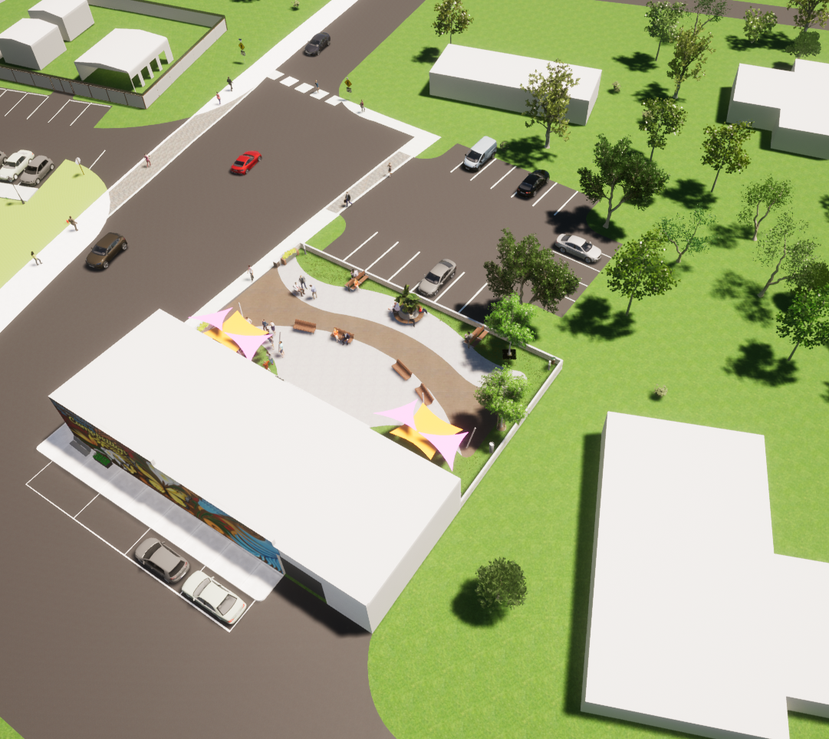
RIF PLANNING GRANT – CAMPBELLTON TOWN CENTER REDEVELOPMENT PLAN
Aerial view of concept design for redevelopment of Old General Store site

Slide 19
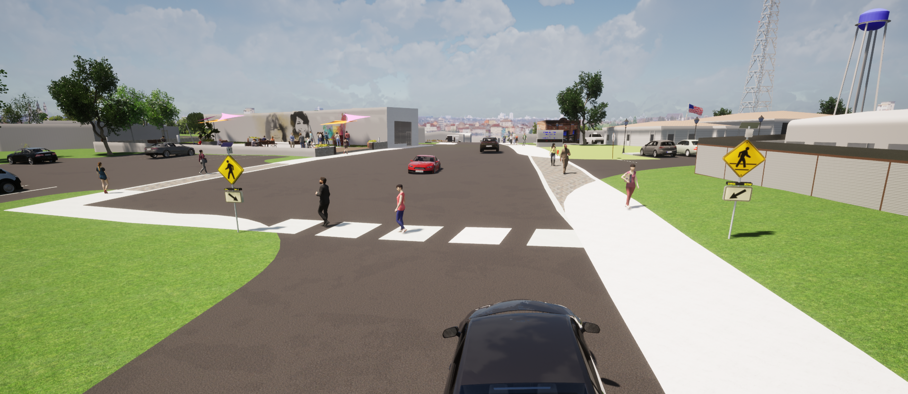
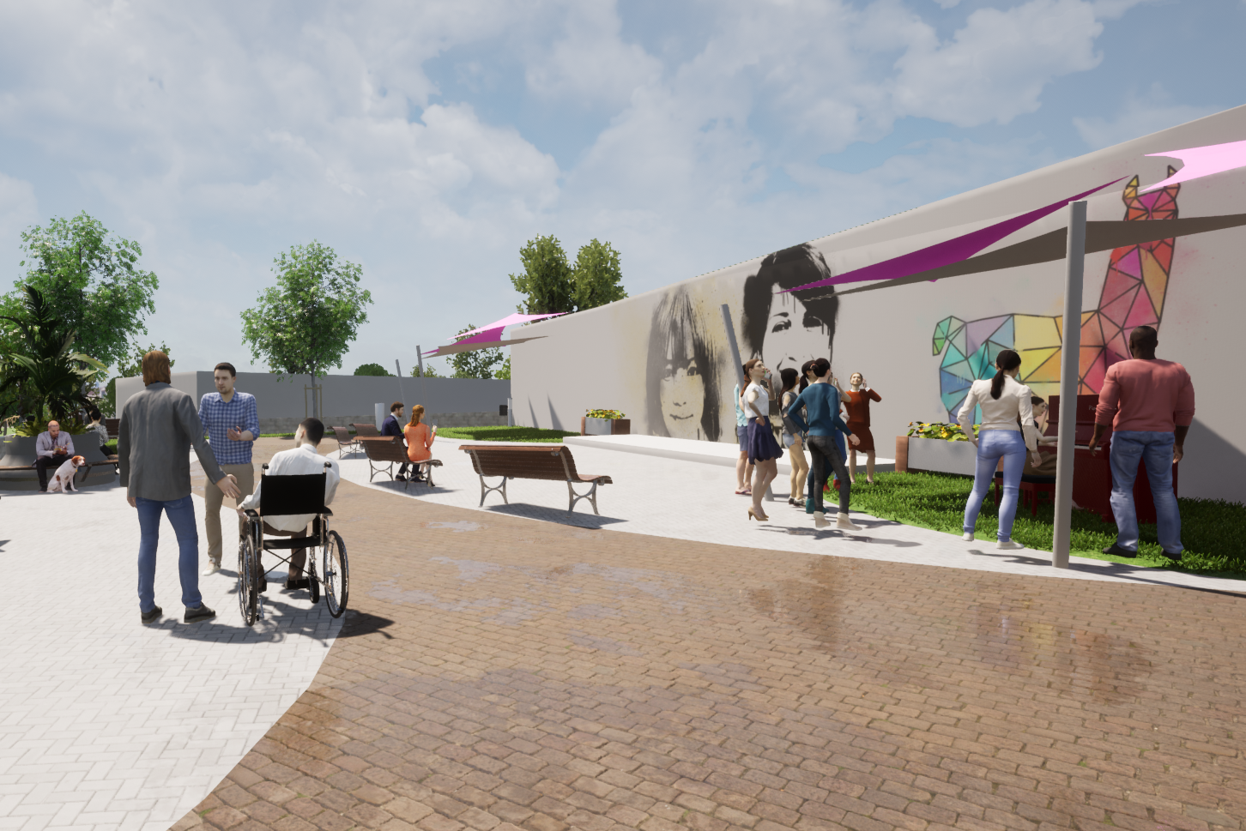
RIF PLANNING GRANT – CAMPBELLTON TOWN CENTER REDEVELOPMENT PLAN
Illustration of Proposed Sidewalks and Crosswalks with RRFBs
Illustration of Proposed Pocket Park
Illustration of Proposed Pocket Park Parking

Slide 20
Recurring Grant Opportunities from FL Department of Economic Opportunity (DEO)
Community Planning Technical Assistance (CPTA) Grant
Competitive Florida Partnership Grant
Rural Infrastructure Fund (RIF) Planning Grant

Slide 21
Questions?
Caroline Smith
ARPC Economic Development Manager
(850) 488-6211 ext. 108
CSmith@arpc.org

