Slide 1
Economic Development Administration (EDA)
Build Back Better Regional Challenge
Grant Application
Caroline Smith
ARPC Economic Development Manager
(850) 488-6211 ext. 108
CSmith@arpc.org

Slide 2
EDA Build Back Better Regional Challenge
U.S. Department of Commerce’s Economic Development Administration (EDA) created a new grant opportunity under American Rescue Plan Act funding called the “Build Back Better Regional Challenge (BBBRC).”
The BBBRC grant aligns with EDA’s updated investment priorities:
Equity
Recovery & Resilience
Workforce Development
Manufacturing
Technology-Based Economic Development
Environmentally-Sustainable Development
Exports and FDI
*highlighted priorities added in 2021

Slide 3
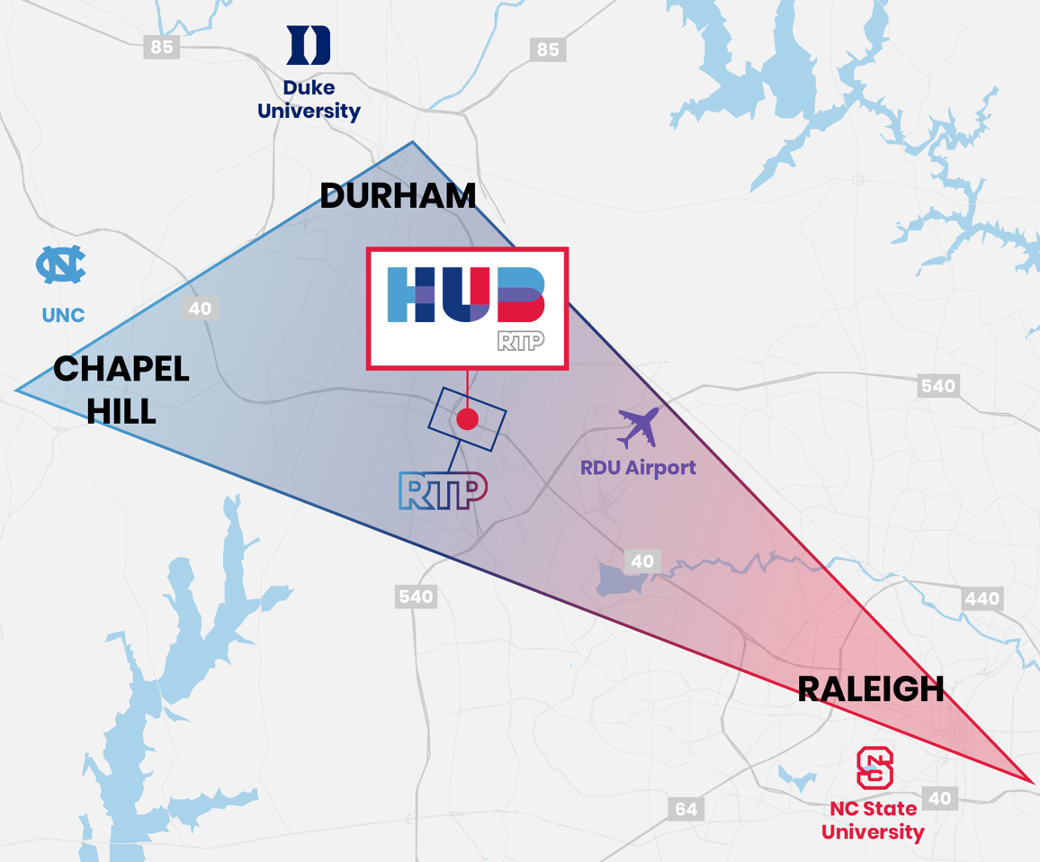
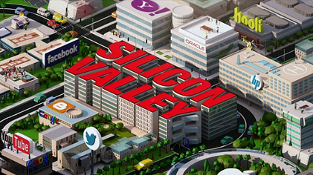
EDA Build Back Better Regional Challenge
Grant Overview – EDA Build Back Better Regional Challenge
Grant Purpose: Develop or grow a regional industry cluster.
What is an Industry Cluster? Industry clusters are a collection of related businesses, subindustries, educational institutions, and other partners that are geographically close to each other with aligned interests. The proximity and alignment give the entities a competitive advantage.
Some examples of successful industry clusters include Research Triangle and Silicon Valley.

Slide 4
EDA Build Back Better Regional Challenge
Grant Overview – EDA Build Back Better Regional Challenge
2-step grant application process:
Phase 1: Up to $500,000 in planning dollars to get projects ready for implementation and work on Phase 2 application. 50-60 regions from across U.S. will be awarded Phase 1 funding.
Phase 2: $25-$75 million may be awarded per proposal for implementation. 20-30 regions from across U.S. will be awarded Phase 2 funding.

Slide 5
EDA Build Back Better Regional Challenge
Grant Overview – EDA Build Back Better Regional Challenge
ARPC submitted application for Phase 1 funding in October 2021
Proposed geography covers 9-county Apalachee Region
No match required for Phase 1 funding
Collaborative, multi-entity application process
ARPC proposal includes set of 8 projects, covering:
Agricultural technology, including industrial hemp processing
Transportation enhancements
Entrepreneurship and workforce support
Total EDA request: appx. $500,000

Slide 6
EDA Build Back Better Regional Challenge
Overview of Proposed Projects (Part I)
Project | Lead Entity | EDA Cost | Match $ / Source | Location / Service Area
Intermodal Logistics Center | City of Gretna | $4,000,000 | $1,000,000 FL Dept. of Economic Opportunity (DEO) Rural Infrastructure Fund (RIF) | I-10 Interchange, Gadsden County. Serves ARPC Region.
Railroad Switchyard Improvements | Florida Dept. of Transportation (FDOT) | $2,500,000 | $1,000,000 FDOT and FGA Railroad | Railroad Switchyard in Leon County
Commercial Vehicle Driving Program Expansion | Tallahassee Community College (TCC) | $2,365,101 | TCC | Tallahassee, Leon County. Drivers serve Region.
Revolving Loan Fund | Apalachee Regional Planning Council | $1,200,000 | $300,000 Franklin County | ARPC Region

Slide 7
EDA Build Back Better Regional Challenge
Overview of Proposed Projects (Part II)
Project | Lead Entity | EDA Cost | Match $ / Source | Location / Service Area
Community Catalysts & Entrepreneurial Centers | Innovation Park | $25,000,000 | $5,000,000 in-kind/Innovation Park/TBD | Serves ARPC Region. 7 centers located in rural ARPC counties.
Entrepreneurship & Commercialization of Tech Programs | Innovation Park | $15,000,000 | Innovation Park/TBD | Entire ARPC Region.
Nexus Hub and Gateway | Florida A&M University (FAMU) | $9,500,000 Hub; $5,125,000 Gateway | State of Florida | FAMU Main Campus. Regional service.
Industrial Hemp Processing Facility | Florida A&M University (FAMU) | $9,250,000 | Industry partners | Gadsden County. Serves ARPC Region.

Slide 8
EDA Build Back Better Regional Challenge
Application “Wins”
Developed new and strengthened existing relationships
Proposal requires the applicant (ARPC) to form a “project coalition” with public and private partners from across the Region. Current members include:
Florida A&M University (merged applications)
Innovation Park in Tallahassee
Florida Department of Agriculture and Consumer Services
Florida Department of Transportation
Florida State University
Tallahassee Community College
Opportunity Florida
Tallahassee-Leon County Office of Economic Vitality
County Economic Development Councils and Chambers
Local Governments
FGA and AN Railroad Operators

Slide 9
EDA Build Back Better Regional Challenge
Application “Wins” (continued)
Strengthened ARPC relationship with Economic Development Administration
Built on foundation set by 850 Hemp Summit
Set stage for creating first industrial hemp processing facility in Apalachee Region
Provided lessons learned for future regional initiatives
Expanding outreach
Actively telling narrative
Increasing transparency in economic development activities

Slide 10
EDA Build Back Better Regional Challenge
Next Steps
Phase 1 awards will be announced mid-December 2021
If awarded funding, ARPC will work with partners to finalize planning activities toward the Phase 2 application
Phase 2 applications will be submitted (and likely awarded) in 2022
ARPC staff will provide future updates on application status and activities related to the EDA Build Back Better Regional Challenge.

Slide 11
Questions?
Caroline Smith
ARPC Economic Development Manager
(850) 488-6211 ext. 108
CSmith@arpc.org

