Slide 1
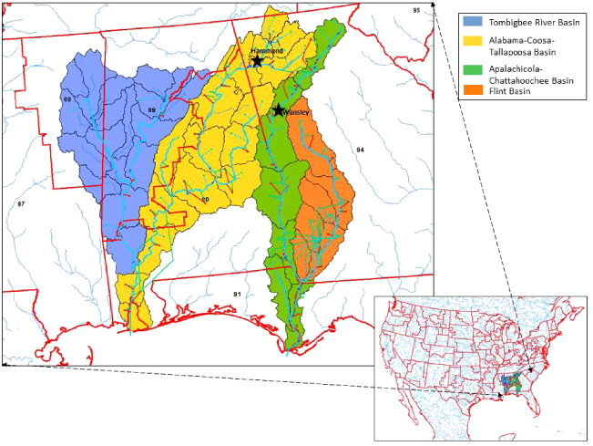
Apalachicola Chattahoochee Flint River Basin (ACF)
Economic Significance to SE Alabama, SW Georgia, and North Florida
Prepared by:
Philip W. Clayton, JD, LLM
Colonel (Ret.)
Executive Director, TriRivers Waterway Development Association
pclayton@eufaulachamber.com
334-695-3433

Slide 2
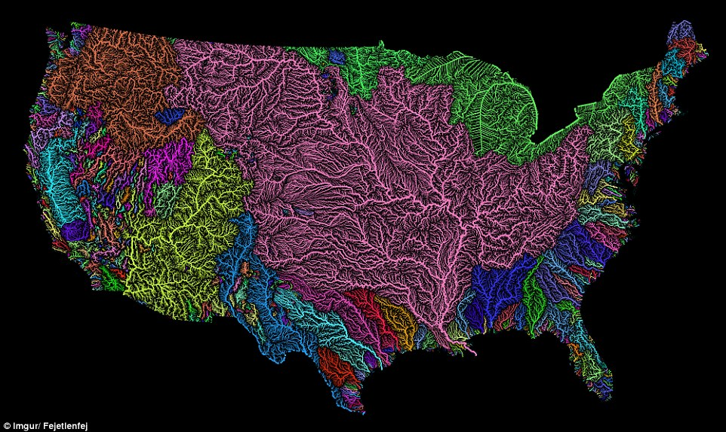
Waters of the United States
http://www.dailymail.co.uk/sciencetech/article-3860062/The-veins-America-Stunning-map-shows-river-basin-US.html

Slide 3
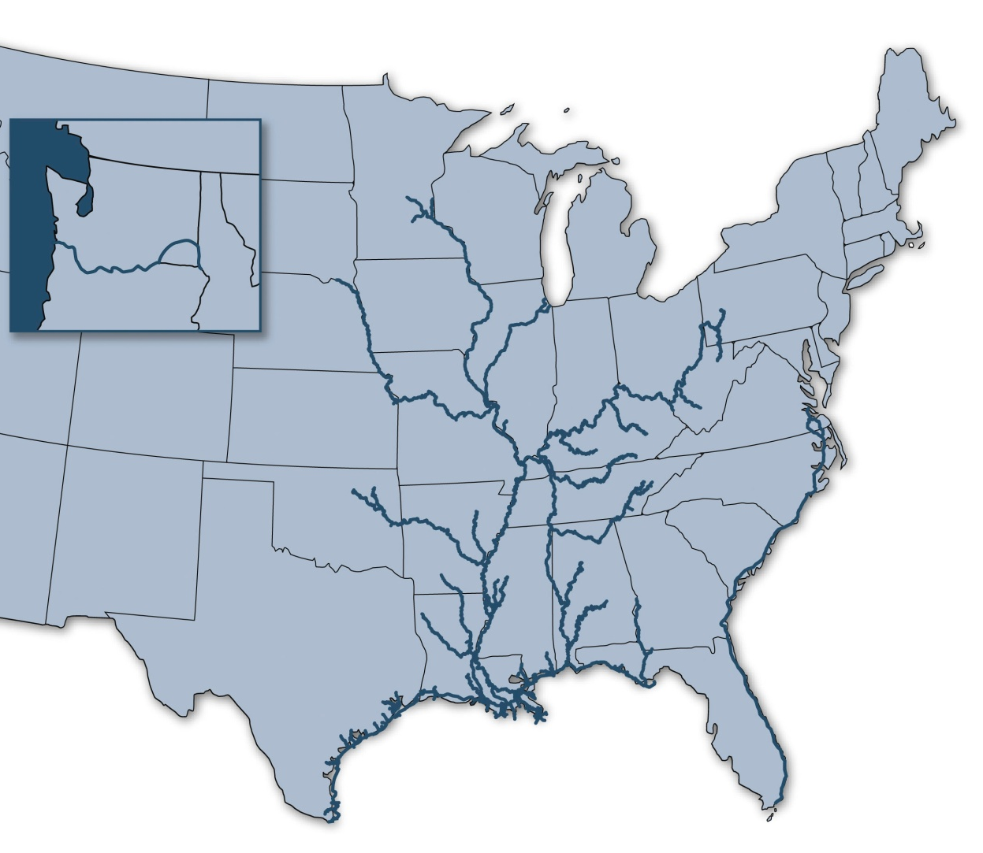
America’s Inland Waterways:
An “Inland Marine Highway” for Freight Transportation
Our “inland marine highways” move commerce to and from 38 states throughout the nation’s heartland and Pacific Northwest, serve industrial and agricultural centers, and facilitate imports and exports at gateway ports on the Gulf Coast.
12,000 miles of commercially navigable channels
192 lock sites
Minneapolis/ St. Paul
Portland
Chicago
Pittsburgh
St. Louis
Tulsa
Houston
Mobile
New Orleans
Corpus Christi
Notes:
Commerce transiting our nation’s inland marine highways moves predominately throughout the nation’s agricultural and manufacturing heartland, as well as in the Pacific Northwest and at gateway ports on the Gulf Coast. These cargoes are mostly “building block” commodities that transit about 12,000 miles of navigable channels and through 192 lock sites. The ACF accounts for 290 miles of the 12,000 (2.5%)

Slide 4
ACF Project Information
Navigation
~$6.2 B in lock infrastructure sitting unused and with very limited maintenance since 2003
261 Miles of authorized channel from Gulf Intracoastal Waterway (GIWW) to Columbus, GA
Dredging of Apalachicola segment (FL) last occurred in 2001
US Army Corps of Engineers (USACE) will not allocate resources per the OMB utilization algorithm (maintenance requirements X commercial utilization = annual funding)
USACE annual appropriation for all Civil Works is ~~$8.6 Billion (FY2024)
USACE 2020 estimate of $94.2 mil to repair all 3 locks and spillways (1.6% of the annual budget)
Estimate includes $43 mil to repair spillway gates (Storage and Flows)
With locks repaired the system is 65-70% reliable for commercial nav most years (Nov – Jul)
Limited dredging may be required at Mile Marks 77.8, 40.5, and 36.5 (~< 9 miles of channel)
Limited dredging, even to 7.5 feet, in the shallow areas improves reliability to 90-95%
$10 mil annually needed to keep project at acceptable level of maintenance (utilization will allow funding through the annual civil works appropriation)
Notes:
$10 mil annual maintenance includes regular channel maintenance of the lower Apalachicola, increased lock maintenance that includes periodic lock closures.

Slide 5
ACF Project Information
Economics^{2&3}
The tri-state region bounding the lower ACF is an economically depressed area
Poverty rates in the region are nearly twice that of the national average
The economic potential of commercial navigation are significant to the region
Greatly reduces the wear and tear on existing road infrastructure due to heavy loads
Current Industry and Water Supply – tristate $7.1B and 39,000 jobs
Current Tourism – tristate $662M and 5,100 jobs
Commercial Navigation – tristate²
Currently 27 potential users identified – includes National Defense, renewable energy (wood pellets and nuclear)
Est. 80 to 416 barge shipments per year (23,296 truck equivalent loads)
Potential for over 3.33 million tons of cargo annually
At 2.1 mil tons, potential for over 29,400 new jobs and $1.99 billion in total economic impact over 10 years³
Yields an additional $2.4 billion in tax revenue over ten years (18:1 ROI for government investment of $136 million for repairs)³
Notes:
Navigation restoration estimate is based repair on the system and performing closures at all three locks for essential, routine and backlog maintenance.

Slide 6
Rate of Return and Net Increase in Total Economic Impact of Lower ACF Basin Restoration Under Alternative Assumptions
Total Economic Impact for the Lower ACF Basin
Growth Assumption | Tons | Direct Employment Impact (JOBS) | Direct Output Impact | Output Total Impact | Net Increase in Output | Average Annual Rate of Return (Present Value) | Return for $1 in Spending (Present Value) (ROI)
27.5% | 446,250 | 6,266 | $235m | $423m | $91m | 0% | $1.0
50% | 525,000 | 7,372 | $277m | $498m | $166m | 4% | $2.0
75% | 612,500 | 8,600 | $323m | $581m | $249m | 18% | $3.0
100% | 700,000 | 9,829 | $269m | $664m | $322m | 24% | $4.0
500% | 2,100,000 | 29,487 | $738m | $1,994m | $1,700m | 178% | $18
Historic average tonnage
Achievable average tonnage
Source: Deravi, M. Keivan, PhD. Economic Research Services, Inc., August 2021, The Economic Impact of Restoration of Infrastructure on the Lower Apalachicola-Chattahoochee-Flint River Basin.

Slide 7
Increase in Total Economic Impact of Lower ACF Basin Restoration Under Alternative Assumptions for Alabama
Economic Impact for Alabama
Tons per Year | Tons Per Year | Direct Employment Impact (JOBS) | Direct Output Impact | Output Total Impact
50.00% | 525,000 | 2,875 | $108m | $194m
75.00% | 612,500 | 3,354 | $126m | $227m
100.00% | 700,000 | 3,833 | $105m | $259m
500.00% | 2,100,000 | 11,500 | $288m | $778m
Source: Deravi, M. Keivan, PhD. Economic Research Services, Inc., August 2021, The Economic Impact of Restoration of Infrastructure on the Lower Apalachicola-Chattahoochee-Flint River Basin.

Slide 8
Increase in Total Economic Impact of Lower ACF Basin Restoration Under Alternative Assumptions for Georgia
Economic Impact for Georgia
Tons per Year | Tons Per Year | Direct Employment Impact (JOBS) | Direct Output Impact | Output Total Impact
50.00% | 525,000 | 3,760 | $141m | $254m
75.00% | 612,500 | 4,386 | $165m | $296m
100.00% | 700,000 | 5,013 | $137m | $339m
500.00% | 2,100,000 | 15,038 | $376m | $1,017m
Source: Deravi, M. Keivan, PhD. Economic Research Services, Inc., August 2021, The Economic Impact of Restoration of Infrastructure on the Lower Apalachicola-Chattahoochee-Flint River Basin.

Slide 9
Increase in Total Economic Impact of Lower ACF Basin Restoration Under Alternative Assumptions for Florida
Economic Impact for Florida
Tons per Year | Tons Per Year | Direct Employment Impact (JOBS) | Direct Output Impact | Output Total Impact
50.00% | 525,000 | 737 | $28m | $50m
75.00% | 612,500 | 860 | $32m | $58m
100.00% | 700,000 | 983 | $27m | $66m
500.00% | 2,100,000 | 2,949 | $74m | $199m
Source: Deravi, M. Keivan, PhD. Economic Research Services, Inc., August 2021, The Economic Impact of Restoration of Infrastructure on the Lower Apalachicola-Chattahoochee-Flint River Basin.

Slide 10
ACF Project Funding
USACE allocated $74.6 million beginning in FY 2024 from Bipartisan Infrastructure Legislation (BIL) waterway infrastructure fund to the Mobile District for Jim Woodruff lock and dam at Lake Seminole and Walter F. George lock and dam at Lake Eufaula.
Senators Tuberville and Britt requested $20.635 million in a Congressionally Directed Spending addition for FY 2024 for George W. Andrews lock and dam at Columbia, Alabama.
The Energy and Water Appropriations Act of 2024 which contains the $20.635 million is signed into law.
$95.235 million is now available to the Mobile District and should fund all lock restoration on the ACF.
Funding for dredging, dredge material disposal, and channel restoration operations are coming in future years requests.
Notes:
$10 mil annual maintenance includes regular channel maintenance of the lower Apalachicola, increased lock maintenance that includes periodic lock closures.

Slide 11
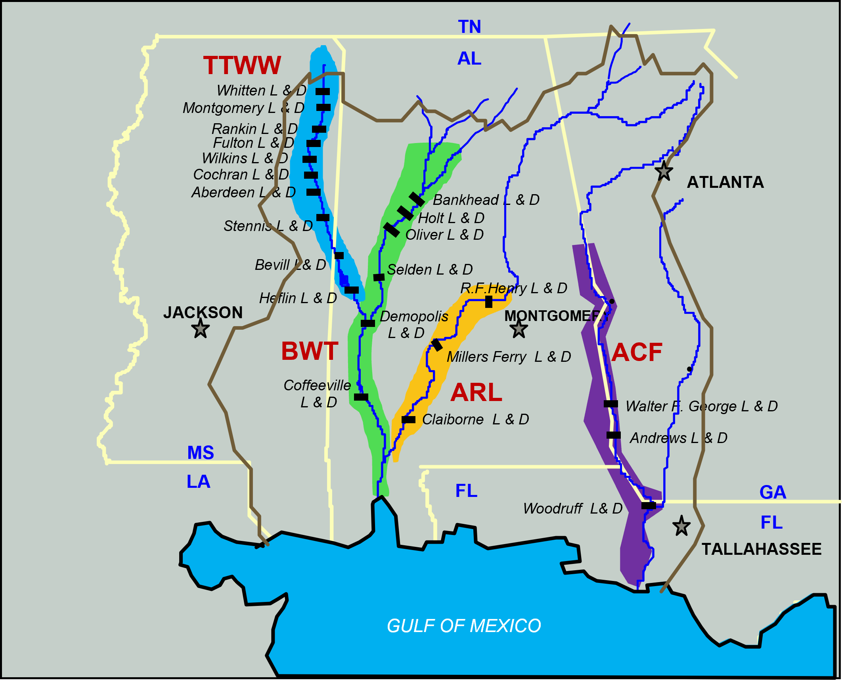
MOBILE DISTRICT
LOCK CLOSURE SCHEDULE
March 2023
Jun 22
Dec 22
Sep 22
Sep 28
Mar 23
Dec 28
Jun 23
Jun 24
Jun 25
Dec 25
Mar 28
Mar 25
Sep 25
Mar 26
Jun 27
Jun 28
Jun 29
Sep 23
Sep 24
Mar 29
Dec 23
Dec 24
Mar 24
Dec 27
Sep 26
Sep 27
Dec 26
Jun 26
Mar 27
Wilkins Lock Closure
Cochran Lock Closure
TTWW
Whitten Lock Closure
Aberdeen Lock Closure
Stennis Lock Closure
Demopolis Lock Failure
Demopolis Lock Closure
BWT
Coffeeville Lock Closure
Closure Devices HSS Inspection/Repair
Jim Woodruff Lock Closure
Geo. W. Andrews Lock Closure
ACF
WFG Unwatering Plan & System Repairs
Walter F. George Lock Closure
DURATION
FUNDED
REQUESTED
SCHEDULE FLEX
Notes:
Notes for Leadership:
All lock closures are considered routine O&M and are done during the low water periods for the inland rivers, which is typically JUNE-SEPTEMBER. Planned routine closure duration is 30 days to accommodate industry users’ schedules. Mobile strives for a 10-year routine closure cycle for each lock, on high use systems. Current District Fleet capacity can perform 4 routine closures on the high use systems (BWT/TTWW), provided the locks are adjacent to each other on the systems and the river distance between locks is not excessive.
Low use systems (ACF/ARL) can only accommodate one closure at a time due to number of stoplogs available. Longer closures on low use systems (ACF/ARL) will have little affect on current NAV traffic. No District Fleet support on the ACF at present.
Whitten Culvert Design funded with FY22 IIJA, working with EN/ERDC/INDC on design. Lock closure also funded with FY22 IIJA that will be carried over to FY24 for execution. Whitten lock closure will cover culvert repair install and continuation of lower gate girder stiffening from FY14 & FY19 closures.
Demopolis and Coffeeville Locks lower miter gates are both funded within the signed FY23 Pbud. Demopolis Lock gates are in worse condition and are the priority. Could push Coffeeville lock gate fabrication for industry capacity.
The Coffeeville and Demopolis Lock closure packages will be pushed to FY25 and FY26 to allow for gate fabrication. O&M contractor capacity and industry crane availability is not sufficient to install two sets of miter gates at different locations simultaneously, Coffeeville install moved to FY26..
Aberdeen and Stennis Locks closures are within the Tier 1/2 ceiling of the Chief’s FY24 Budget Request. We have requested funding in FY23 on the Mississippi Senators needs requests. Funding these closures in FY23 would be ideal in helping the closure schedule execution, other option is move to FY25 for execution.
Wilkins and Cochran Locks closures are on the proposed FY24 IIJA funding list.
Woodruff dewatering plan package pending funded by reprogramming of funds from the FY22 ACF Dredging Permit workplan package.
Walter F. George Dewatering Plan/Work package is on Senator Shelby’s FY23 funding needs request and available for FY23 Workplan. Dewatering plan will be led by EN.
Walter F. George Lock closure is on the proposed FY24 IIJA list but will have to be pushed to a future FY for execution. Dewatering plan will have to be completed first and Woodruff lock closure will have to be completed before George. There is only one set of navigation stoplogs on the system so only one lock can be closed at one time.
George Andrews Lock closure package has not been picked up in any budget cycle or the IIJA requests. It is in the budget system and available for any funding source. Ideal path would be to conduct the Andrews closure after Woodruff and before George (accomplish closures going upstream on the system).

Slide 12
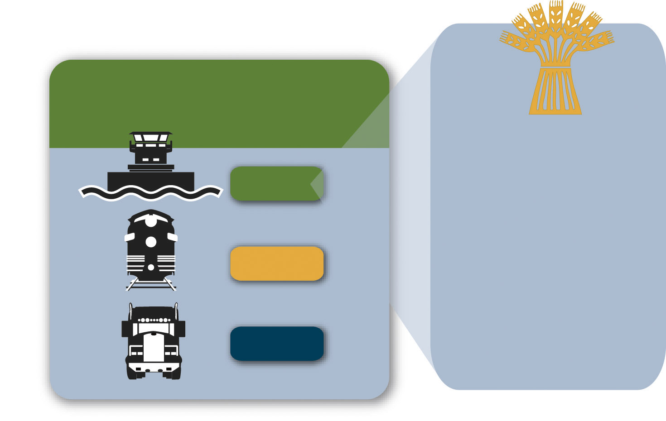
Advantages of Inland Waterways Transport:
Easing Rail and Highway Congestion in Our Communities
Units to Carry 1,750 Short Tons of Dry Cargo
1 barge
16 rail cars
70 trucks
One loaded covered hopper barge carries
58,333 bushels of wheat, enough
to make almost 2.5 million loaves
of bread.
Notes:
The TTI report compared the cargo capacity of a barge, a rail car, and a semi-truck. It found that one dry cargo barge carried the equivalent of 16 rail cars or 70 trucks. To provide some dimension to the carrying capacity of one barge, one barge load of wheat could produce 2 1/2 million loaves of bread. That’s nearly one loaf for every person – man, woman and child – in the state of Kansas!

Slide 13
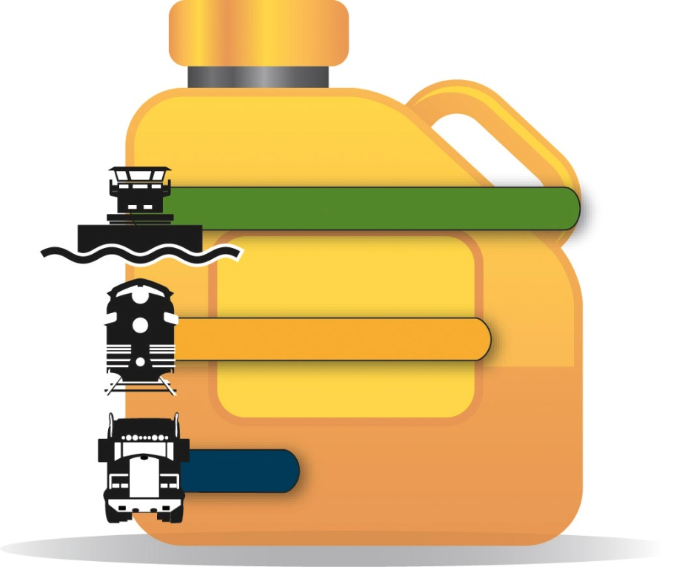
Advantages of Inland Waterways Transport:
Moving Freight Efficiently Throughout America
Transporting freight by water is also the most energy-efficient choice.
Barges can move one ton of cargo 647 miles per gallon of fuel. A rail car would move the same ton of cargo 477 miles, and a truck only 145 miles.
647
477
145
Ton-miles Traveled per Gallon of Fuel
Notes:
Today’s towboat can transport one ton of freight 647 miles per gallon of fuel. A modern locomotive would move that same ton of freight 477 miles per gallon of fuel, and a truck would move it 145 miles. That means barges have an energy efficiency more than 4 times that of trucks.

Slide 14
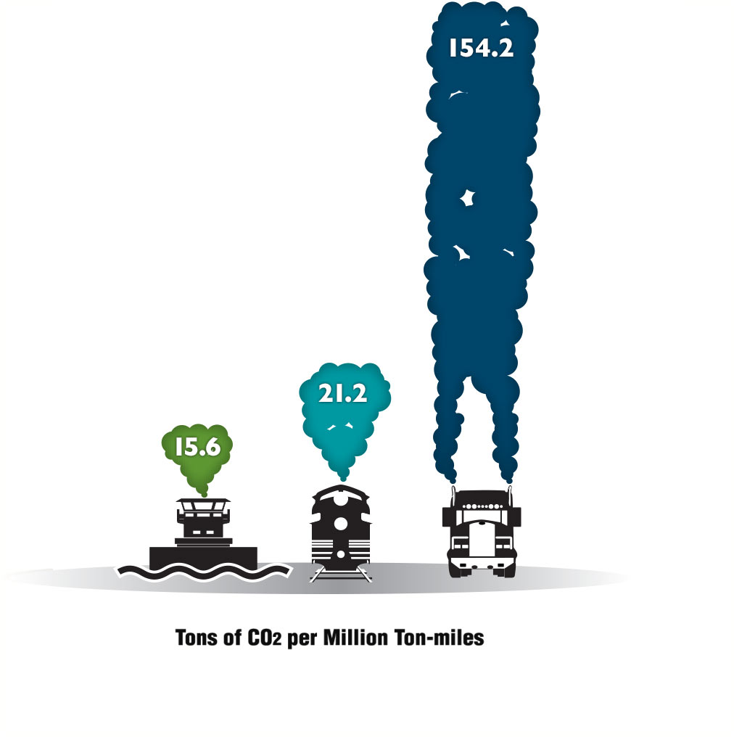
Advantages of Inland Waterways Transport:
The Greener Way to Move America’s Cargoes
Barges have the smallest carbon footprint among other transportation modes.
To move an identical amount of cargo by rail generates 30% more carbon dioxide than by barge, and 10 times more emissions by trucks than by barge.
Notes:
This graphic speaks for itself—inland waterways transportation is the Greener Way to move America’s building-block commodities.

Slide 15
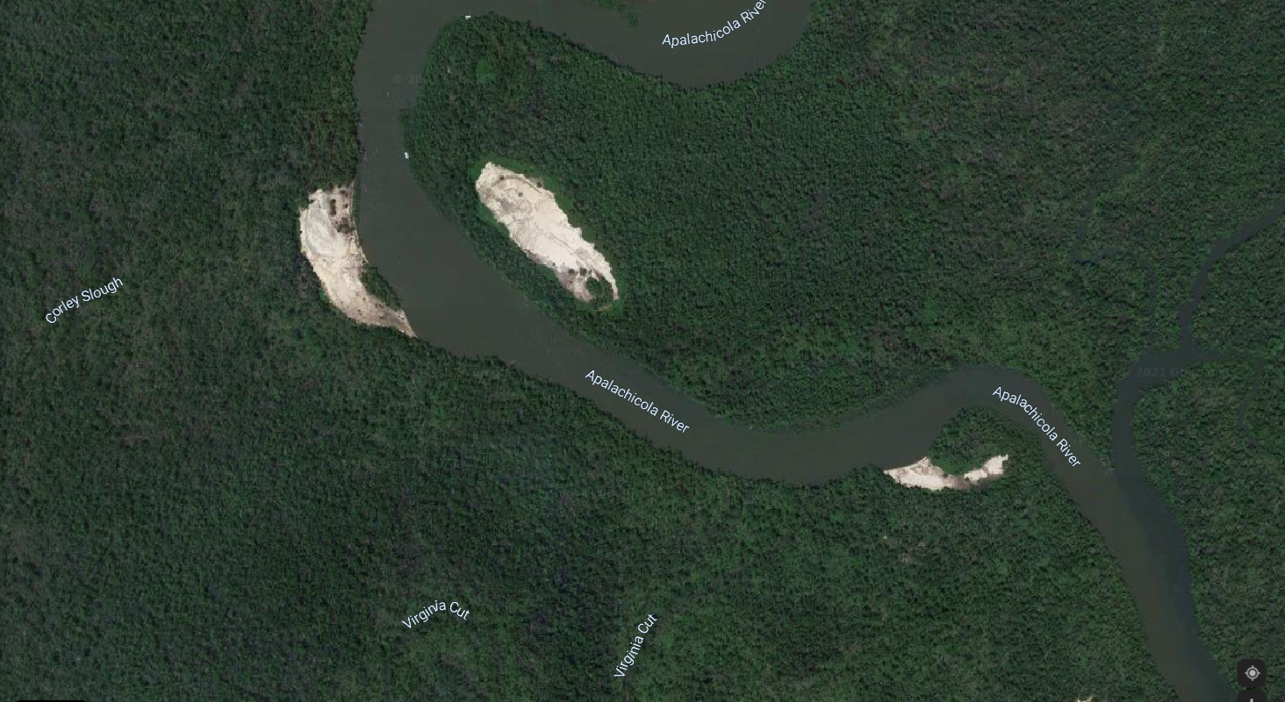
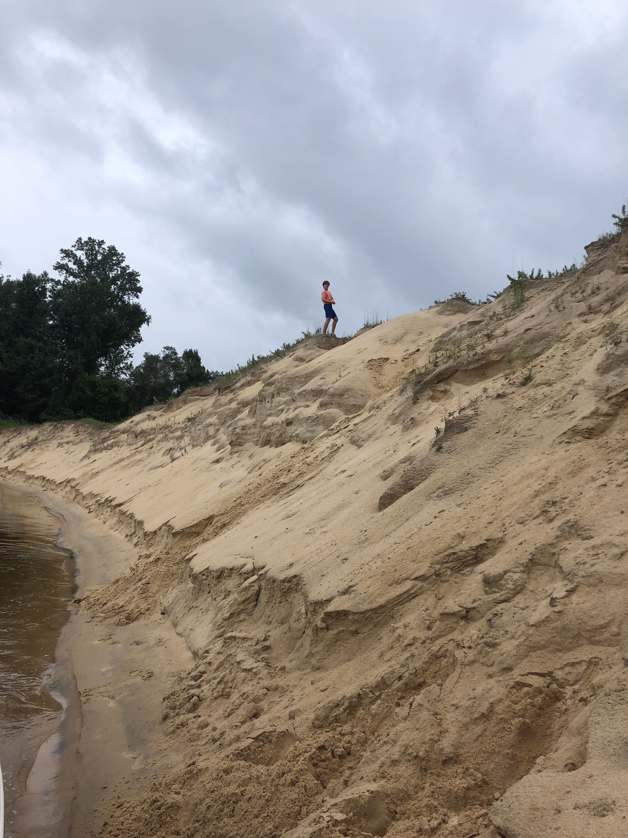
Corley Slough “Sand Mountain”
Environmental Restoration Opportunity
Elliott is 6 feet tall
Site 39 (Liberty Co) is 14.8 acres and 300,000 cu yds
Site 40 (Gulf Co) is 9.7 acres and 500,000 cu yds
Mineral Manufacturing Co is willing to remove the materials and contribute funds for site restoration
One of many possible locations (Within bank disposal areas) for material removal and restoration of native trees and grasses

Slide 16
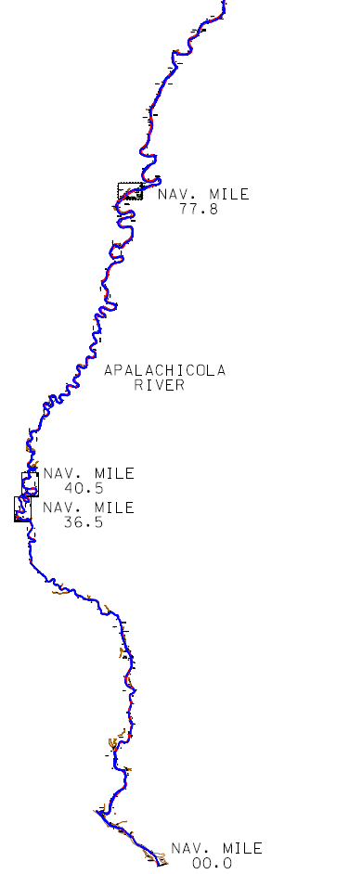
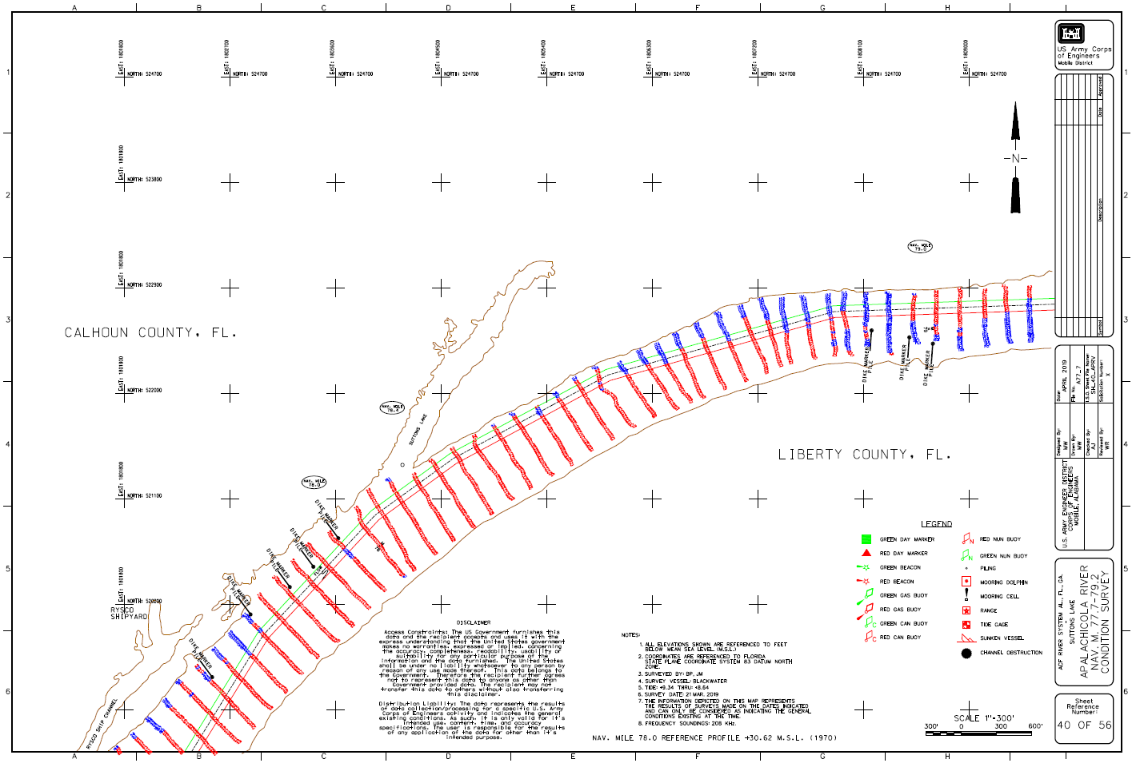
Shallow location on the lower Apalachicola (MM 77.8)
(Red indicates shallow water)

Slide 17
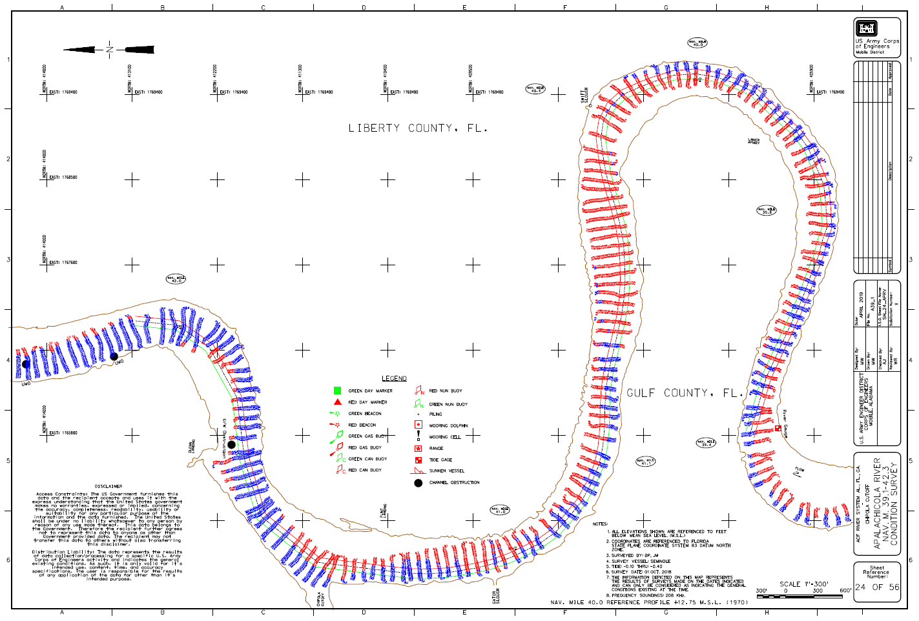
Shallow location on the lower Apalachicola (MM 40.5)
(Red indicates shallow water)

Slide 18
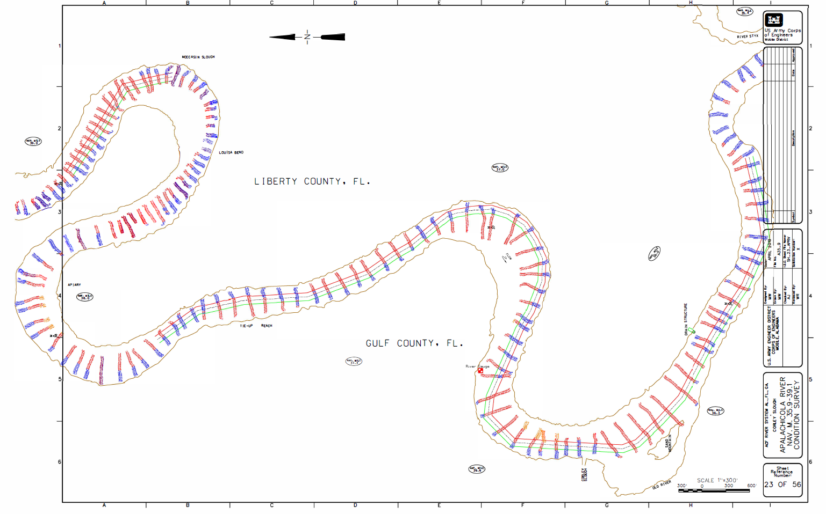
Shallow location on the lower Apalachicola (MM 36.5)
(Red indicates shallow water)

Slide 19
ACF Conclusions and Recommendation
Full potential for over 3.33 million tons of cargo annually
A $136 million repair investment yields over 29,400 jobs and $1.99 billion in total economic output over 10 years.³
Environmental interests must be a part of the conversation as to how channel restoration might be accomplished (techniques, disposal, etc.)
Shallow draft vessels are part of the solution
Flow management for navigation will enhance flows for ecology in the Apalachicola basin.
The ACF is a crucial infrastructure asset to the nation and should be adequately maintained for ecological concerns, health and safety of downstream residences, industrial users, water supply, recreation, and commercial navigation
References:
Mixon, Phillip PhD., Associate Prof of Economics, 2020, January 7, Economic Impact of the Mid/Lower Apalachicola-Chattahoochee-Flint Waterway.
Clayton, Philip JD, LLM, 2020, Aug 20, ACF Customer Utilization Survey, unpublished, Eufaula Barbour Co. Chamber of Commerce.
Deravi, M. Keivan, PhD. Economic Research Services, Inc., August 2021, The Economic Impact of Restoration of Infrastructure on the Lower Apalachicola-Chattahoochee-Flint River Basin.
Prepared by:
Philip W. Clayton, JD, LLM
Colonel (Ret.)
pclayton@eufaulachamber.com
334-695-3433

