Slide 1




An Overview of the Foreign-Trade Zone Program
Kelly Halvorsen
IMS Worldwide, Inc.

Slide 2


Agenda
Foreign-Trade Zone (FTZ) Program History and Structure
Zone Design and Service Area
FTZ Sites, Activities, Benefits
Top Prospects
Next Steps

Slide 3
What is an FTZ?
A Federal program, started in 1934 with 261 current active FTZ projects being administered across the US.
An FTZ is a designated location in the US where companies can use special customs procedures to increase competitiveness with other nations for manufacturing and operations.
A site is granted FTZ status by the US Foreign-Trade Zones Board (FTZ Board) under the US Department of Commerce.
Zone activity cannot occur until the site has been separately approved for activation by local US Customs and Border Protection (CBP) officials. Zone activity remains under the supervision of CBP.

Slide 4
FTZ Key Stakeholders
Grantee = The local authority entrusted with the administration of the program in the local community – Tallahassee International Airport
Operator = A company that operates under Zone Status, within its own facilities for itself or for the account of others – Company, Third-party Logistics Provider
Users = Companies using the FTZ, either as an Operator or within an Operator’s facility – Retail, Manufacturing, Distribution and E-Commerce
US FTZ Board = Provides Grant of Authority to Grantees and authorizes FTZ site and production approvals
US Customs and Border Protection = All FTZ sites must activate with CBP prior to conducting any Zone activity. Local CBP offices oversee FTZ Operators to ensure FTZ regulatory compliance.

Slide 5
US FTZ Structure
US Customs &
Border Protection
US Dept of
Commerce –
FTZ Board
Grantee-
TLH Airport
Site 1: Operator
Third-Party Logistics
Company
Site 2: Operator
Manufacturing
Company
Site 3: Operator
Distribution
Company
Retailer 1
Importer 2

Slide 6
FTZ
Proposed
Service Area
CBP oversight guidelines require that the defined Service Area be within 60 miles / 90-minute drive time rule
Proposed counties for inclusion: Franklin, Gadsden, Jefferson, Liberty, Leon, Taylor, Madison, Gulf, Wakulla, Jackson, and Calhoun
Require letters from each county expressing their support and desire to be part of the new Tallahassee International Airport FTZ project

Slide 7

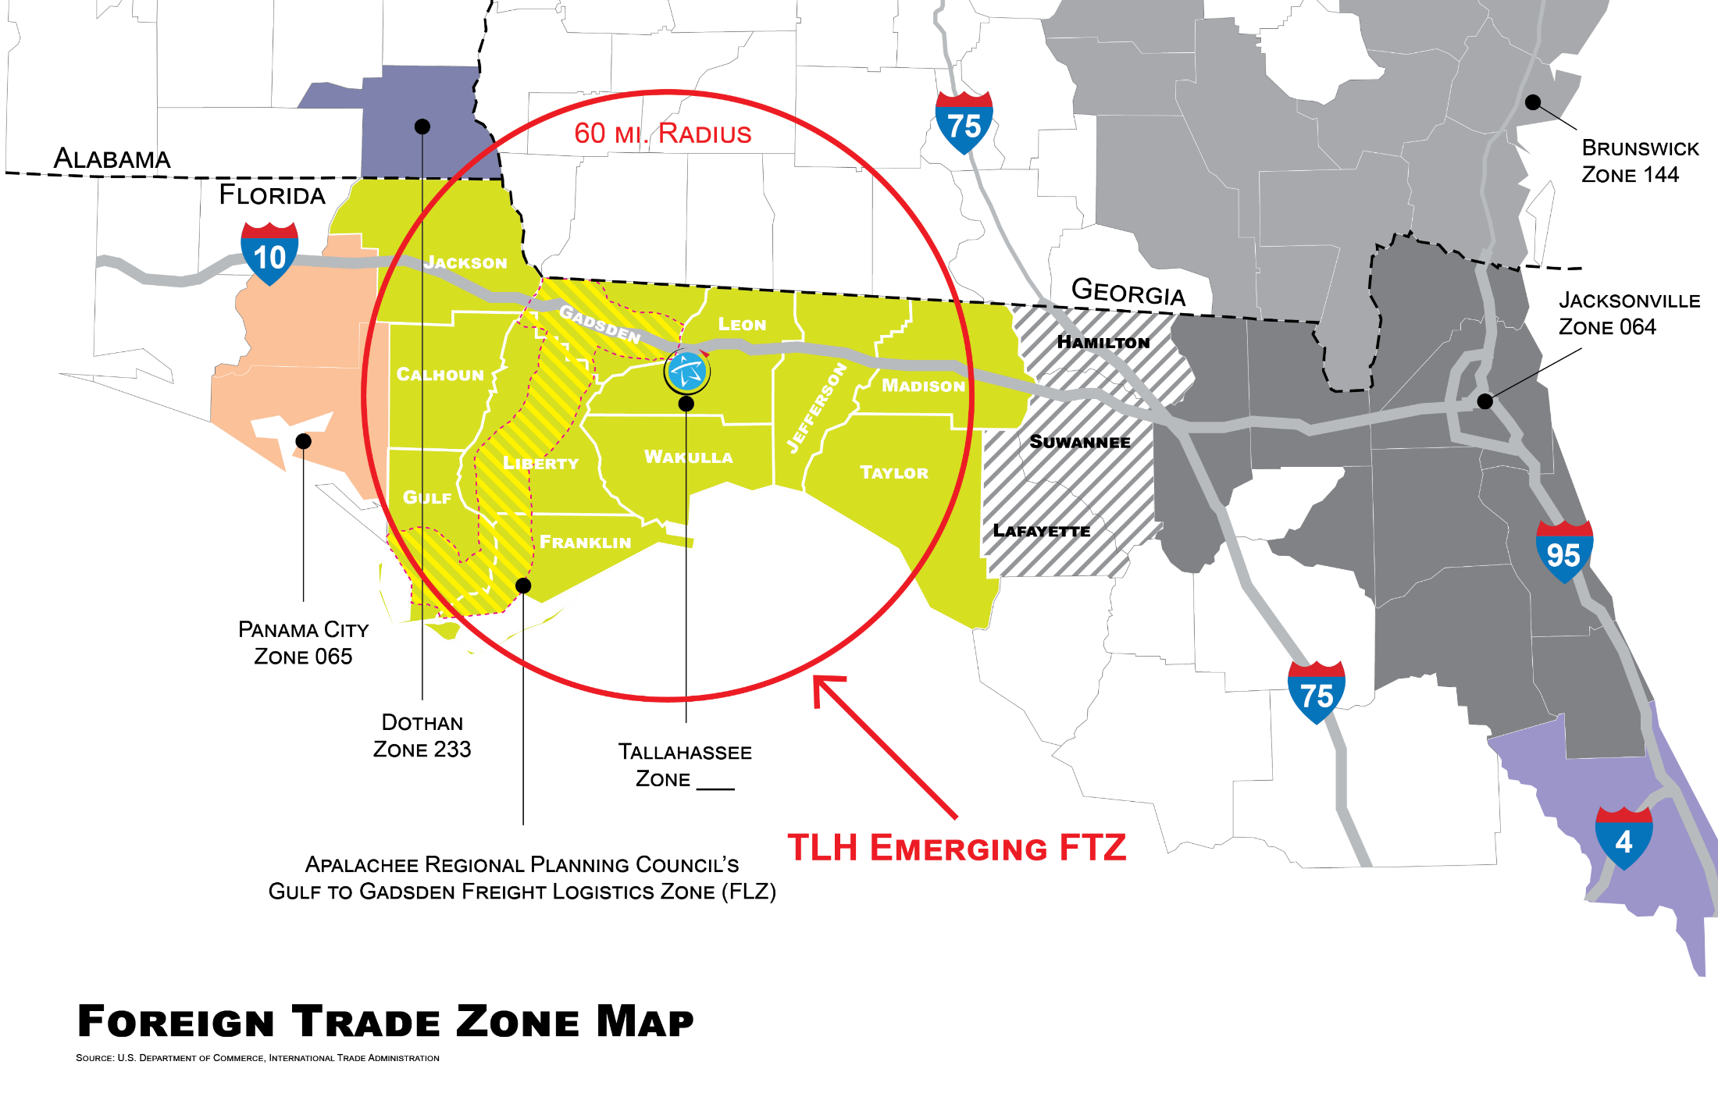
Enlarged Foreign Trade Zone Map

Slide 8
What is a Zone Site?
An Industrial Park or Development
  Magnet Site
A Company’s Facility
  Usage-Driven or Subzone
Multiple Company Locations
  Subzone

Slide 9
What activity can occur within an FTZ?
Distribution
Storage
Testing and Inspection
Repackaging
Assembly
Repair
Scrap
Manufacturing
What activity cannot occur within an FTZ?
Retail operations
Residential usage

Slide 10
Import Duties and Tariffs
Duties and tariffs are types of taxes imposed on foreign goods.
  A tax is a charge imposed on a taxpayer by a government.
  Tariffs are a direct tax applied to goods imported from a different country.
  Duties are indirect taxes that are imposed on the consumer of imported goods.
Tariffs and duties help protect domestic industries by making imports more expensive.
Taxes, duties, and tariffs all contribute to the total import and export costs of a product.

Slide 11
FTZ Operational Benefits
Duty Deferral
Duty Elimination
Duty Reduction
Duty Inversion
Duty Free Export/Scrap
Merchandise Processing Fee Reduction via Weekly Entry
Improved Supply Chain Velocity

Slide 12
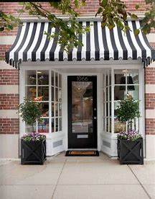

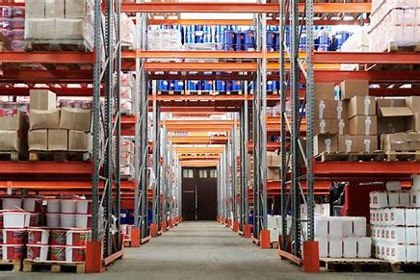
What is an FTZ?
A US FTZ is a secure, geographical area authorized by the federal government, where commercial merchandise, both domestic and foreign, is outside the commerce of the US for Customs purposes.
International Location
US Foreign Trade Zone
US Commerce
Cargo
Duty Paid
on Cargo or Finished Good
Re-Exports
Goods within FTZ Can Be:
Stored
Manipulated
Value-Added
Exported
Scrapped
Duty is never paid on components that remain within the FTZ and are exported.
Deferring duties until goods are needed, can provide significant savings.

Slide 13
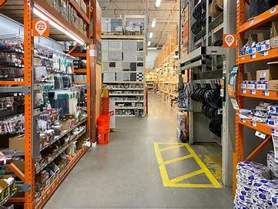
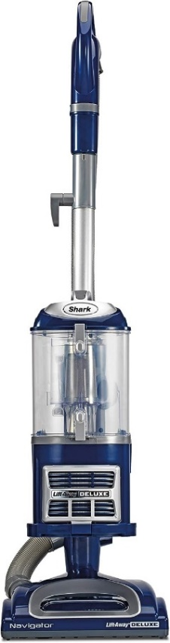
Manufacturing in an FTZ
Duty is inverted if the duty of the finished good is less than the duty of the components.
US Commerce
FTZ Manufacturing Center
International Location
Cargo
Imported Components + Duty Rate:
Duty of the Finished Good is due upon entering US Commerce
Part 1 = 2%
Part 5 = 2.5%
Part 2 = 3.5%
Part 6 = 3.9%
Part 3 = 0%
Part 7 = 1.7%
Vacuum Cleaner Duty Rate = 0%
Part 4 = 5%
Part 8 = 3.3%
With 301 (China Tariffs) +25% Duty on each of the imported components.

Slide 14
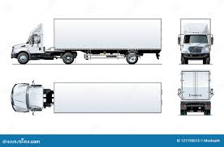
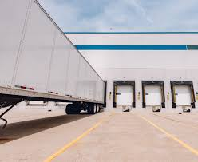
Weekly Entry in FTZ
Reduces Merchandise Processing Fees (MPF) for importers by reducing costs.
Non-FTZ Facility
20 receipts inbound
per week
$538 X 20 = MPF $10,760
FTZ Facility
1 Weekly Entry filed covers all 20 receipts inbound;
1 entry filed = MPF $538
Total Savings:
1 Week = $10,222
1 Year = $531,544

Slide 15
Economic Development Tool
Having an FTZ program is an important recruiting and retention tool for local EDC groups.
Site selection teams often have FTZ as a criterion on their checklists, as it adds value for importers and third-party logistics providers.
FTZ tenants typically have a higher retention rate due to their links to CBP, increased supply chain velocity, and investment in physical security.

Slide 16
FTZ Top Prospects
Global Freight Forwarders/Third-Party Logistics Providers
Retailers
Manufacturers
Cold Chain

Slide 17
Next Steps for Set-up
Identify top companies for FTZ discussions based on import, export, manufacturing, industry type, etc.
Determine FTZ targets by partnering with:
  State, County, Regional and Local EDC Groups
  Industry Trade Groups
Needed for formal FTZ Application:
  Letters of support from counties within the Service Area
  Letters of intent from companies reflecting demand for FTZ services
  Letters from local organizations in support of the FTZ Application

Slide 18


Questions?
Kelly Halvorsen
Director of Zone Applications
IMS Worldwide, Inc.
Office: (281) 554-9099
Email: Kelly.Halvorsen@imsw.com
Vanessa Spaulding, MBA, CIA, CIGA
Manager - Airport FTZ & Air Service Development
Tallahassee International Airport
Office: (850) 891-7895
Email: Vanessa.Spaulding@talgov.com

