Slide 1
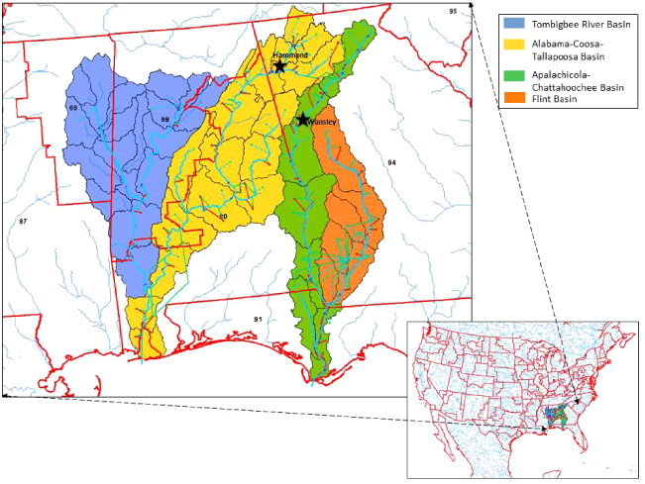
Apalachicola Chattahoochee Flint River Basin (ACF)
Economic Significance to SE Alabama, SW Georgia, and North Florida
Prepared by:
Philip W. Clayton, JD, LLM
Colonel (Ret.)
Executive Director, TriRivers Waterway Development Association
pclayton@eufaulachamber.com
334-695-3433

Slide 2
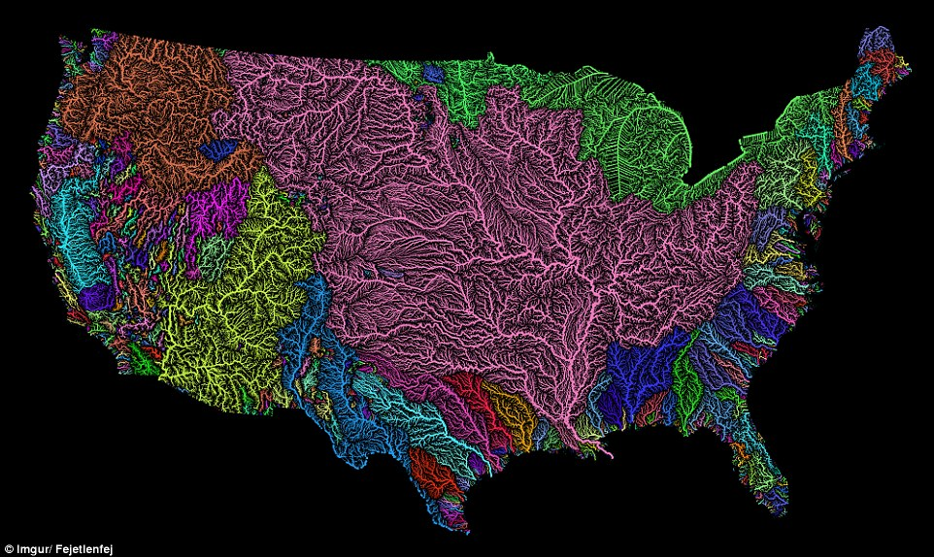
Waters of the United States
http://www.dailymail.co.uk/sciencetech/article-3860062/The-veins-America-Stunning-map-shows-river-basin-US.html

Slide 3
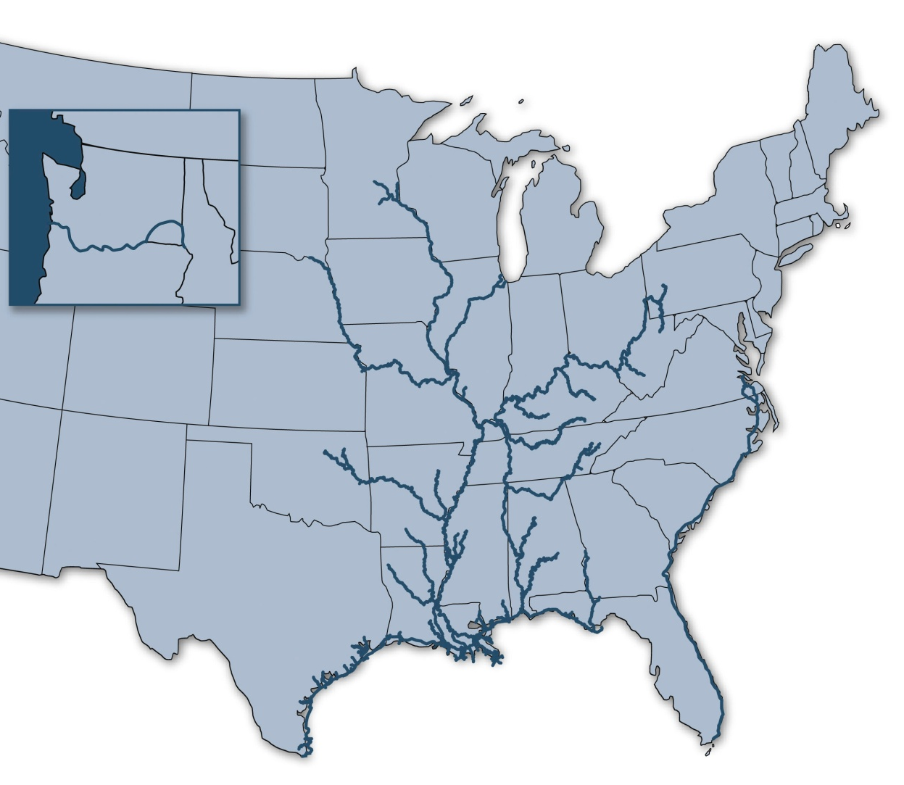
America’s Inland Waterways:
An “Inland Marine Highway” for Freight Transportation
Our “inland marine highways” move commerce to and from 38 states throughout the nation’s heartland and Pacific Northwest, serve industrial and agricultural centers, and facilitate imports and exports at gateway ports on the Gulf Coast.
12,000 miles of commercially navigable channels
192 lock sites
Minneapolis/ St. Paul
Portland
Chicago
Pittsburgh
St. Louis
Tulsa
Houston
Mobile
New Orleans
Corpus Christi
Notes:
Commerce transiting our nation’s inland marine highways moves predominately throughout the nation’s agricultural and manufacturing heartland, as well as in the Pacific Northwest and at gateway ports on the Gulf Coast. These cargoes are mostly “building block” commodities that transit about 12,000 miles of navigable channels and through 192 lock sites.

Slide 4
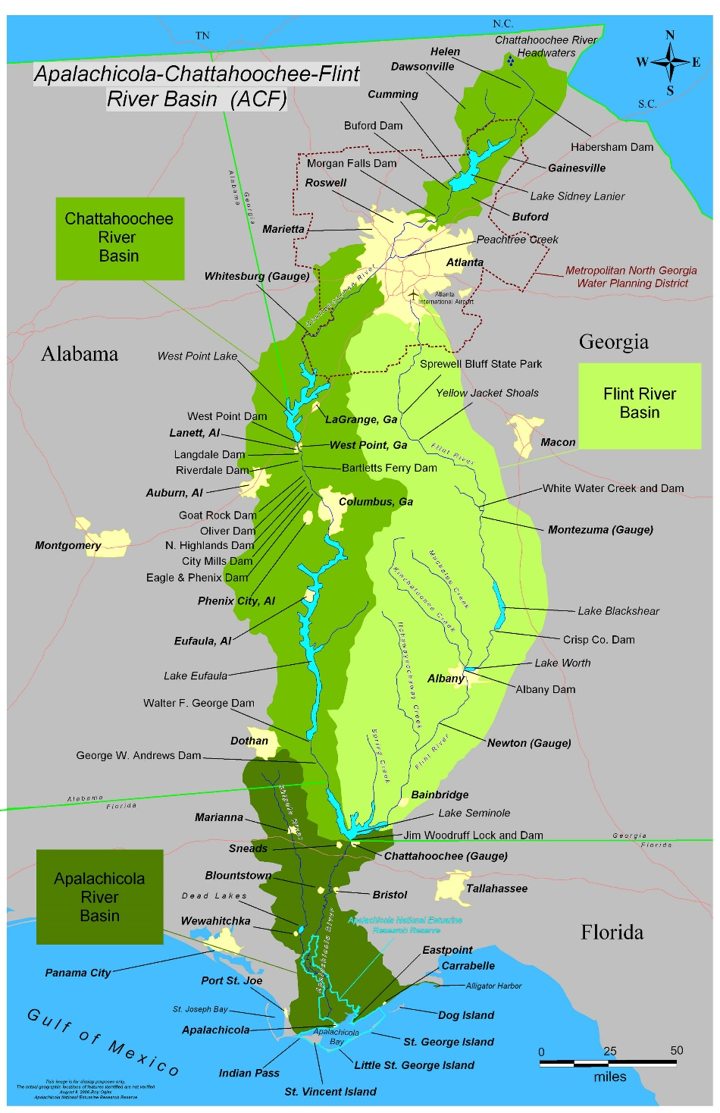
ACF Facts and Figures¹
ACF Drainage basis is 20,355 sq miles
Avg daily water withdrawal is 1,645 Mgal/d.
65% surface water
35% ground water
75% of withdrawals support agriculture
ACF economic influence in the middle Chattahoochee, lower Chattahoochee, lower Flint, and Apalachicola sections:
Six Florida counties
Eleven Georgia counties
Six Alabama counties

Slide 5
ACF Project Information
Navigation
~$6.2 B in lock infrastructure sitting unused and unmaintained since 2003
290 Miles of 9-feet authorized channel from Gulf Intercostal Waterway (GIWW) to Columbus, GA
Dredging of Apalachicola segment (FL) last occurred until 2001
US Army Corps of Engineers will not allocate resources for per the OMB utilization algorithm
US Army Corps of Engineers annual appropriation for Civil Works is ~~$8.5 Billion
USACE 2020 estimate of $94.2MM to repair all 3 locks and spillways
Estimate includes $43MM to repair spillway gates (Life, health, safety issue)
With locks repaired the system is 65-70% reliable most every year (Nov – Aug)
Dredging required at Mile Marks 77.8, 40.5, and 36.5 (~~ 9 miles of channel)
Dredging improves reliability to 90-95%
$10M annually needed to keep project at acceptable level of maintenance
Notes:
Navigation restoration estimate is based on dredging the lower Apalachicola and all shoals on the system and performing closures at all three locks for essential, routine and backlog maintenance.
$10M annual maintenance includes regular dredging of the lower Apalachicola, increased lock maintenance that includes periodic lock closures.

Slide 6
ACF Project Information
Economics²
The tri-state region bounding the lower ACF is an economically depressed area
Poverty rates in the region are nearly twice that of the national average
The economic potential of commercial navigation are significant to the region
Greatly reduces the wear and tear on existing road infrastructure due to heavy loads
Current Industry and Water Supply – tristate $7.1B and 39,000 jobs
Current Tourism – tristate $662M and 5,100 jobs
Commercial Navigation – tristate³
Currently 27 potential users identified – includes National Defense, renewable energy (wood pellets and nuclear)
Est. 80-416 barge shipments per year (23,296 truck equivalent loads)
Over 3.33 million tons of cargo annually
Potential for Florida is 2,950 new jobs and $200 million in total economic output
At 2.1 mil tons, potential for over 29,400 new jobs and $1.9 billion in total economic impact over 10 years
Notes:
Navigation restoration estimate is based on dredging the lower Apalachicola and all shoals on the system and performing closures at all three locks for essential, routine and backlog maintenance.
$10M annual maintenance includes regular dredging of the lower Apalachicola, increased lock maintenance that includes periodic lock closures.

Slide 7
Rate of Return and Net Increase in Total Economic Impact of Lower ACF Basin Restoration Under Alternative Assumptions
Growth Assumption | Tons | Direct Employment Impact (JOBS) | Direct Output Impact | Output Total Impact | Net Increase in Output | Average Annual Rate of Return (Present Value) | Return for $1 in Spending (Present Value)
27.5% | 446,250 | 6,266 | $235m | $423m | $91m | 0% | $1.0
50% | 525,000 | 7,372 | $277m | $498m | $166m | 4% | $2.0
75% | 612,500 | 8,600 | $323m | $581m | $249m | 18% | $3.0
100% | 700,000 | 9,829 | $269m | $664m | $322m | 24% | $4.0
500% | 2,100,000 | 29,487 | $738m | $1,994m | $1,700m | 178% | $18

Slide 8
FUTURE LOCKAGE INFORMATION
REQUEST FOR LOCKAGES
Floodgate for New Orleans District, Catfish Bayou
Steward Machine, Bainbridge (Woodruff/Seminole Lock)
Bauxite from Port St. Joe to Columbia State Dock (Eufaula State Dock at future date)
Material Manufacturing Corp (Woodruff/Seminole Lock, GW Andrews Lock, and WF George Lock)
POTENTIAL LOCKAGES
Farley Nuclear
Reactor parts due to size and weight – 75’ x 250’ barge
Mobile District
Spillway gate for Tenn-Tom Waterway

Slide 9
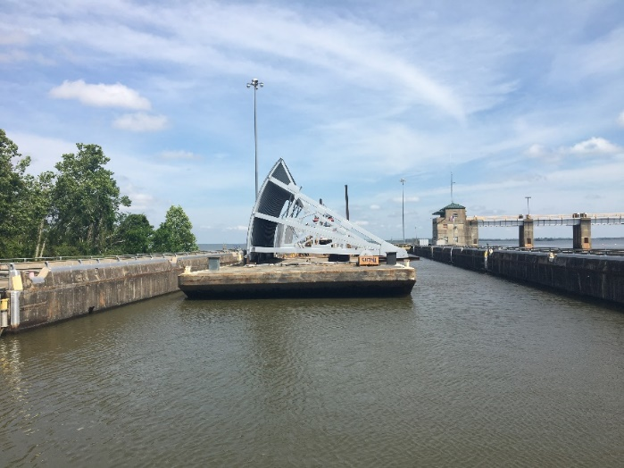
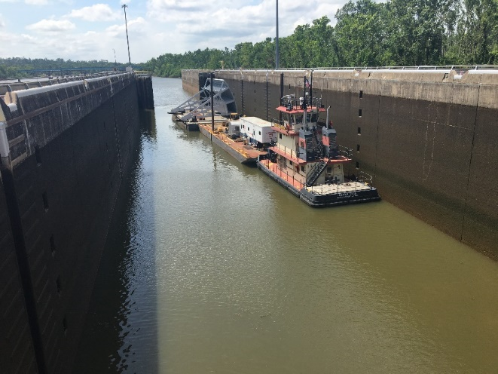
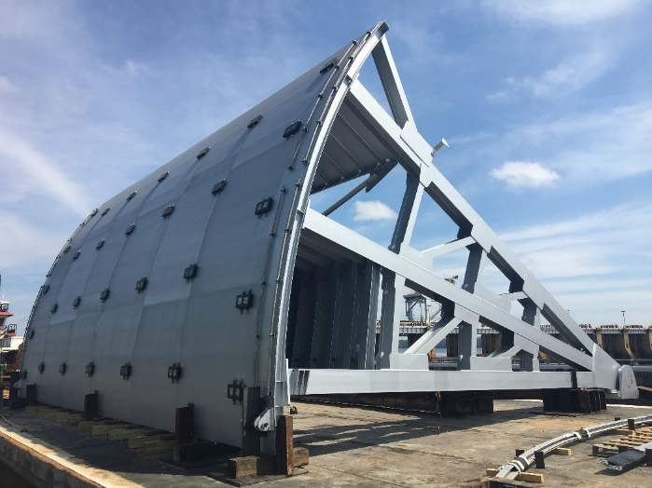
Tainter Gate – Stennis Lock & Dam

Slide 10
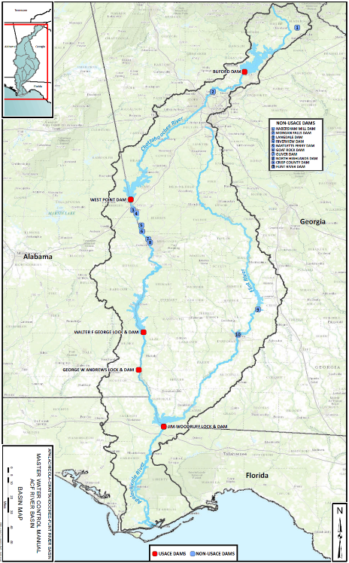
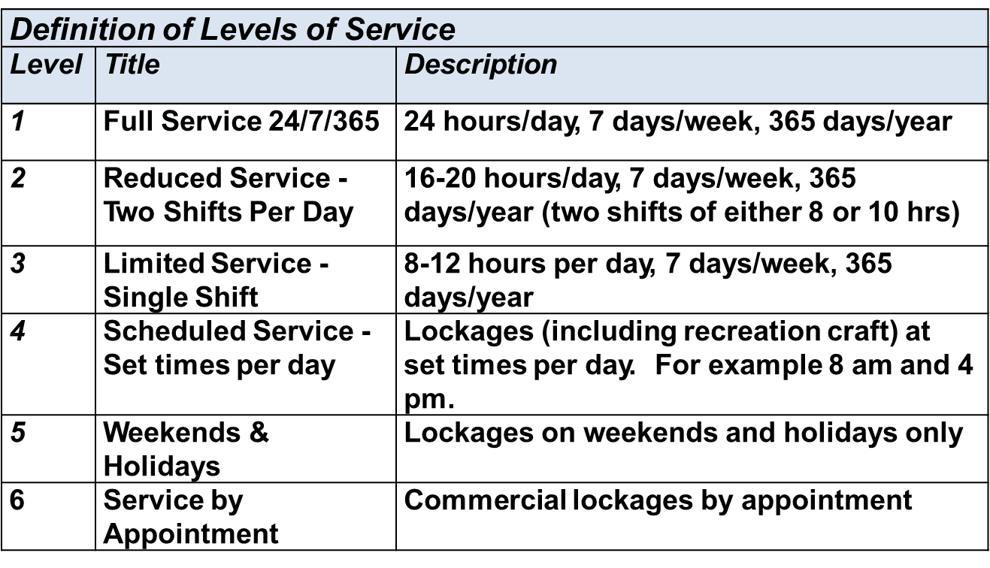
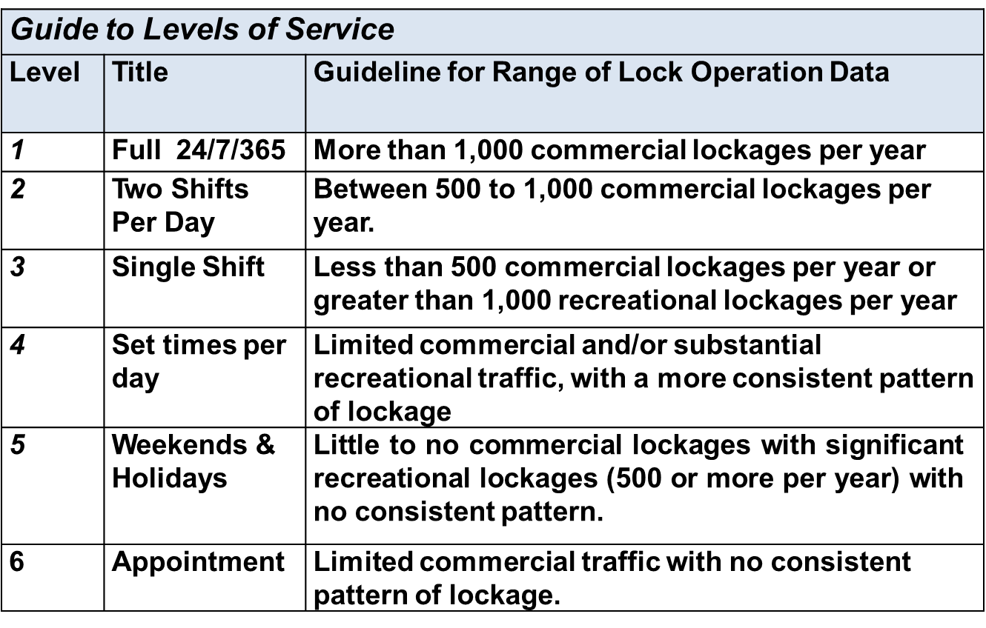
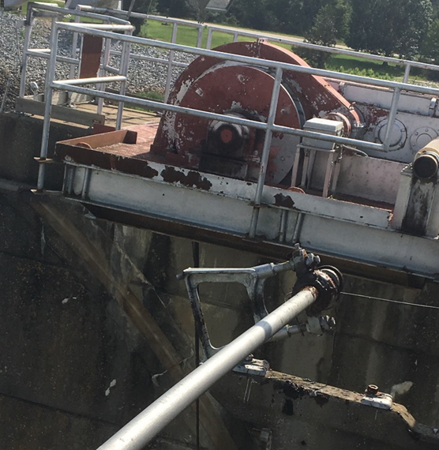
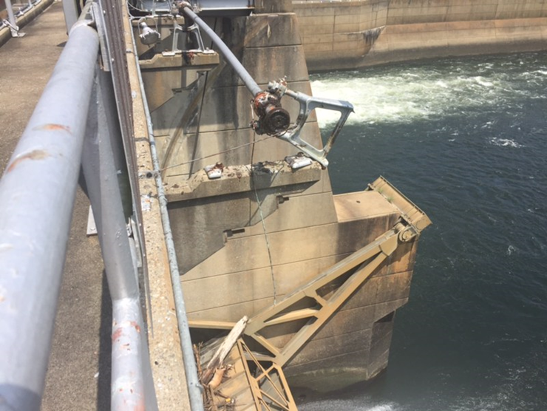
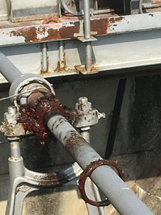
ACF RIVER BASIN - LOCK OPERATIONS AND STATUS
JIM WOODRUFF
Operating at LOS 6, lockages by appointment only
Operator on duty Monday-Thursday from 0600-1600 for maintenance activities
Recreational lockage by appointment & if coincides with maintenance activities when lock operators on site
Movement LS upper gate anchor arm/pin. Limited use of gate. 41 ft limit on width.
Lock has a substantial backlog of unfunded maintenance
IMTS LEVELS OF SERVICE
GEORGE W. ANDREWS
George W. Andrews
A cast steel gimbal mount that allows the hydraulic cylinder to move while operating the valve sheered apart from corrosion and fatigue cracks
Cracks were found in the gimbal mounts of the other 3 valve cylinders
Lock will remain closed to navigation until repairs are affected and preserve remaining existing machinery for emergency lockage of Government assets
Lock has a substantial backlog of unfunded maintenance
Estimated repair costs are $300K/cylinder. Not funded in current or future budgets.
Walter F. George
George W. Andrews
Jim Woodruff
Walter F. George
WALTER F. GEORGE
Currently closed to commercial and recreational traffic due to identified deficiencies on the lower miter gates
Estimated budget to repair is $3.5 million. Not funded in current or future budgets.
Will remain closed to navigation until repairs are affected
Lock has substantial backlog of unfunded maintenance
Notes:
SAM began the update process for the water control manuals in 1989.
After multiple attempts to update the manuals and solve the “water wars,” were unsuccessful, then Secretary of the Army Pete Gerhan directed SAM to focus solely on updating the manuals.
Previous attempts include compacts, mediation, governors, state proposals, etc.
USACE has been sued in federal court on many occasions in ACF & ACT basins.
Many stakeholders have conflicting desires/interests, even within their own organizations.
For instance, the local populace around Westpoint would like higher pools for recreation, but 40 miles downstream in Columbus, the desire is for a minimum flow of 1350 cfs, more than twice the required minimum flow set in the authorization for Westpoint.
RELATIONSHIPS with stakeholders at all levels was/is key.
Worked tirelessly at all levels, from the working level to the Senior Executive level, to reach consensus with USFWS on a non-jeopardy biological opinion within 60 days of an accepted biological assessment.
Engaged directly and on multiple occasions at all levels of USACE and the ASA (CW)’s office to gain concurrence to release the final EIS and WCM for state and agency review.
Released the FEIS and WCMs for state and agency review on 16 DEC 2016.
The technical team continues to engage with those agencies reviewing the documents to answer questions, provide access to the models, and keep open and transparent communication with the stakeholders.

Slide 11
ISSUES FOR THE LOCKS AND WATERWAY
WOODRUFF/SEMINOLE LOCK
Upper Landside Anchorage Pin – Movement is anchorage assembly/limits ability to swing gate
Only one fill valve and one drain valve operational
GW ANDREWS LOCK
Chamber silted in at lower gates limits opening width the 42 ft.
Chamber silted in at upper gates limits draft of vessel when chamber lowered
WF GEORGE LOCK
Major concerns with swinging lower gate – banging noises and difficulty getting proper miter
High lift lock (84’) safety concerns with locking vessels. Engineering support required for each lockage
WATERWAY
Apalachicola River - Mile 4.5 shifting channel hard to raise lake level, Blountstown, Chipola, & Wewahitchka
Chattahoochee River – Lower approach to GW Andrews shoaling

Slide 12
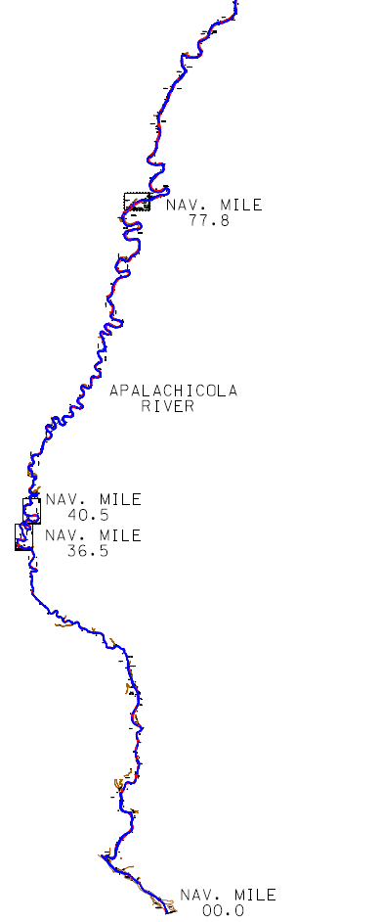
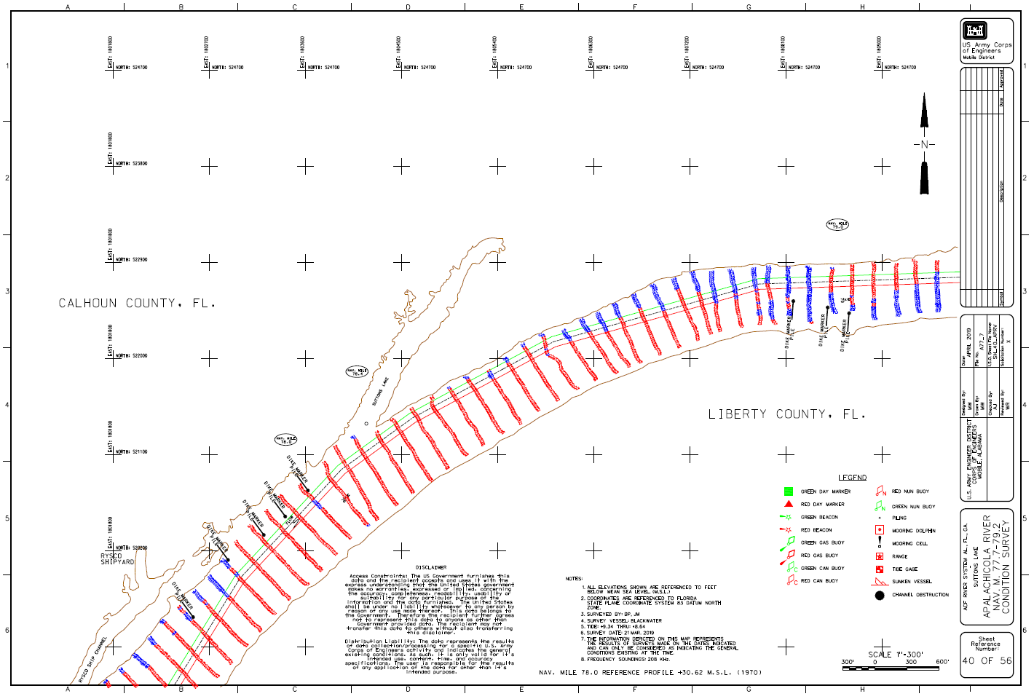

Slide 13
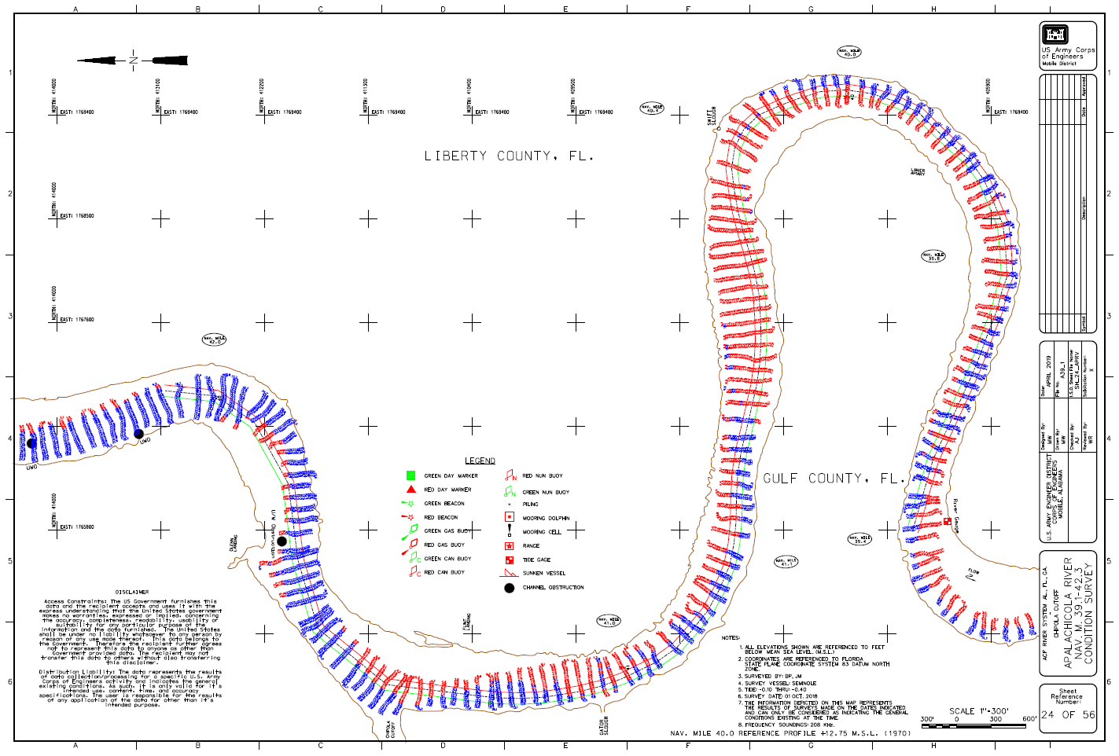

Slide 14
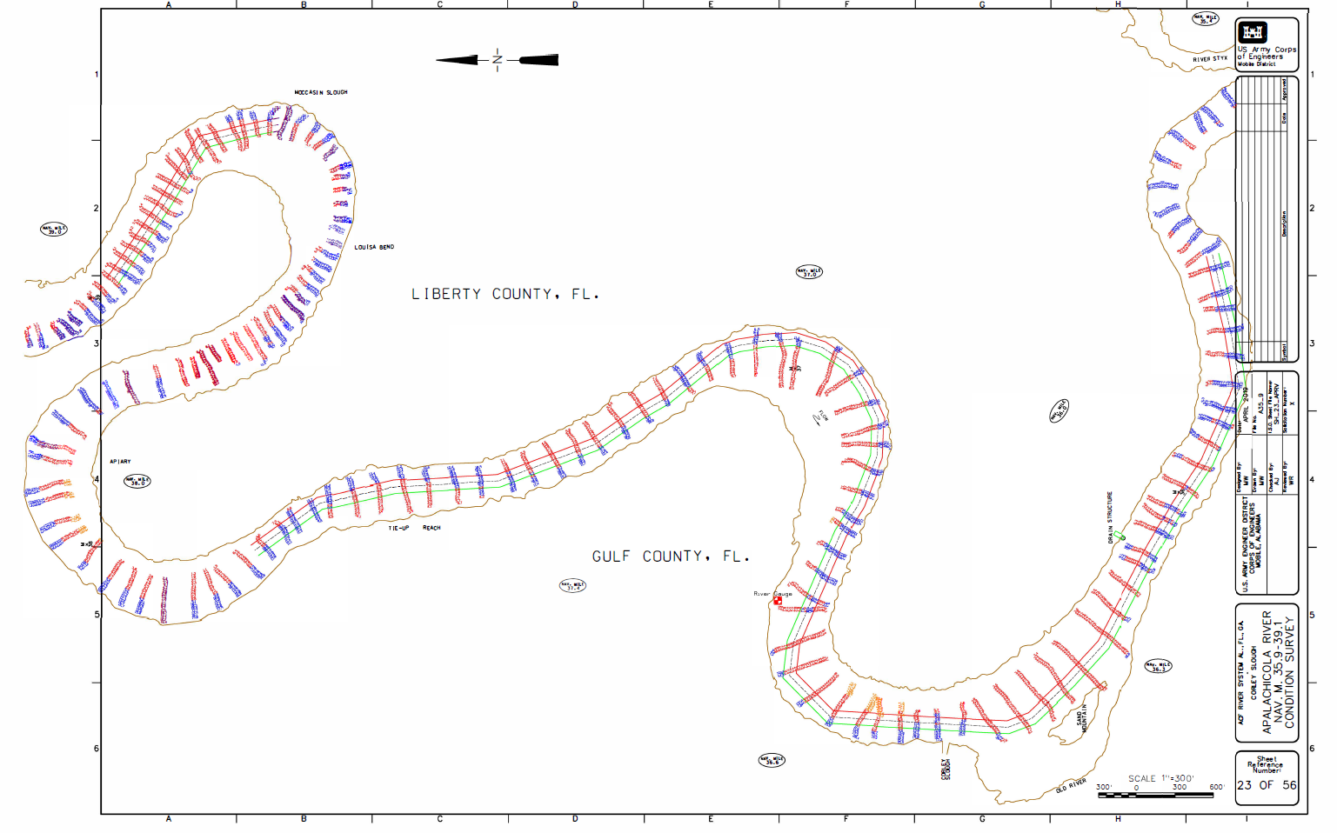

Slide 15
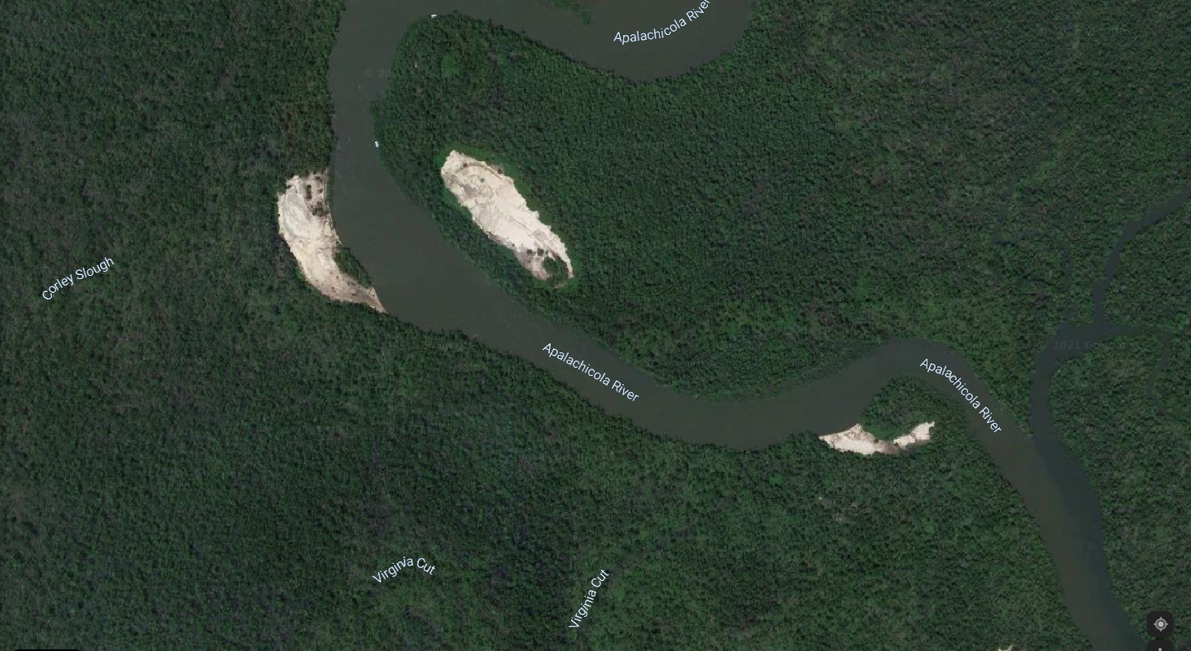
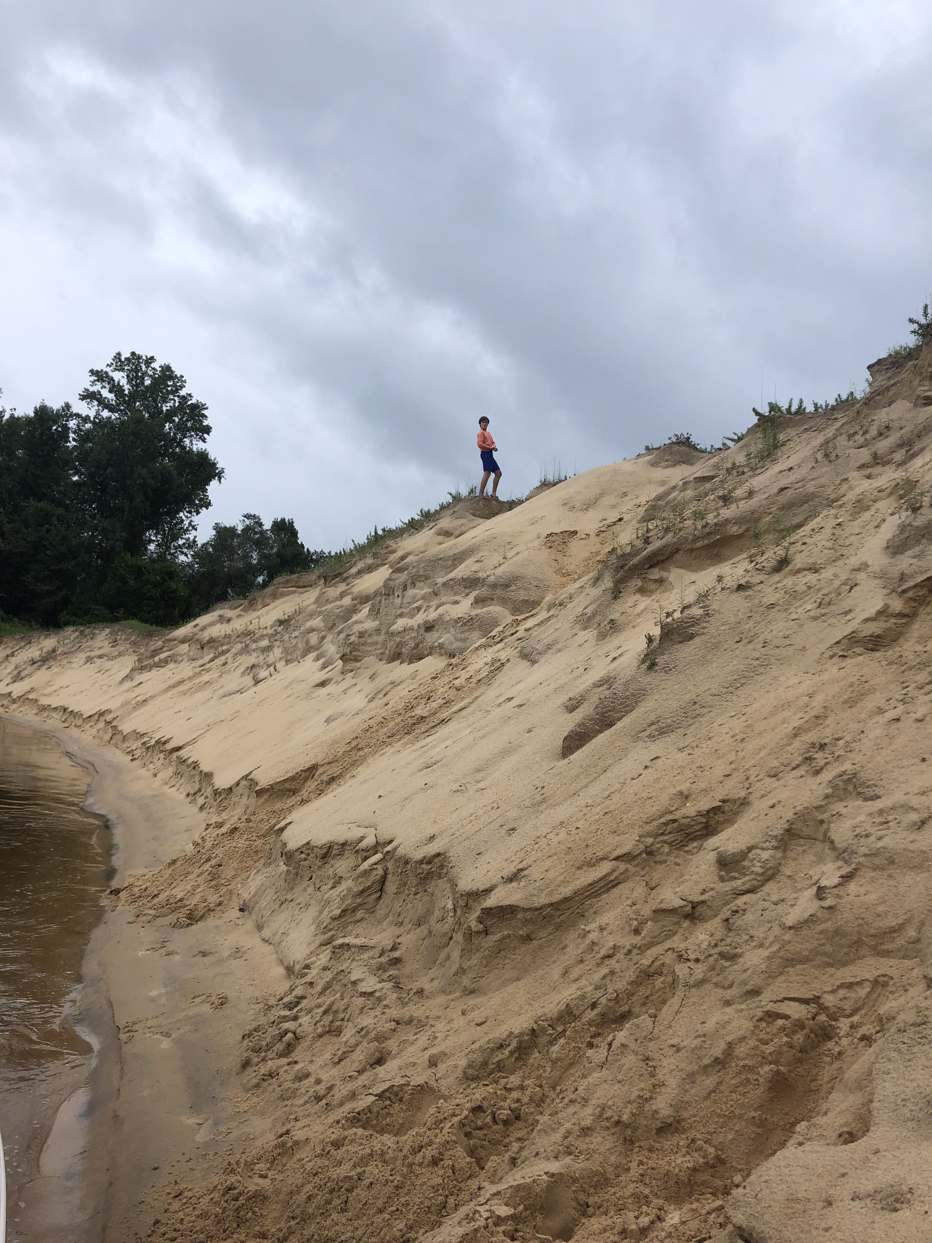
Corley Slough
Site 39 (Liberty Co) is 14.8 acres and 300,000 cu yds
Site 40 (Gulf Co) is 9.7 acres and 500,000 cu yds
Mineral Manufacturing Co is willing to remove the materials
One of many possible locations for material removal and restoration of native trees and grasses

Slide 16
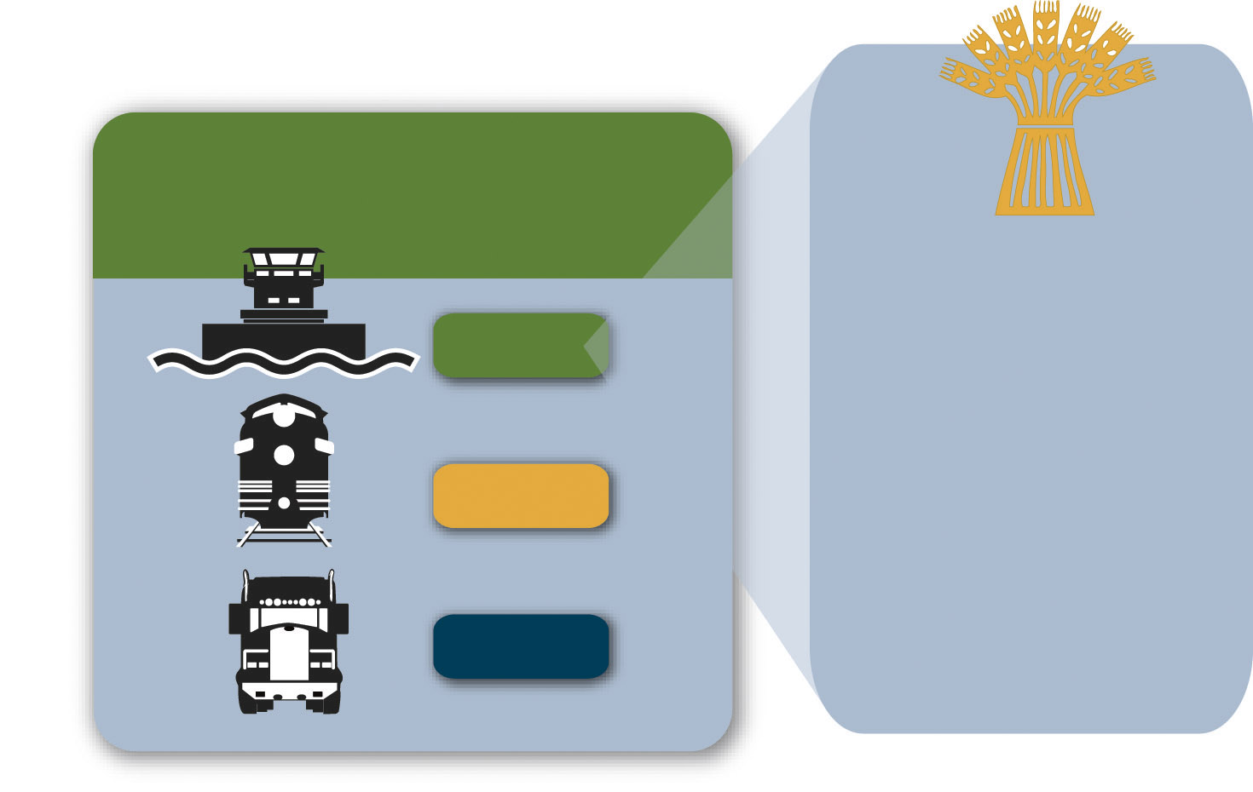
Advantages of Inland Waterways Transport:
Easing Rail and Highway Congestion in Our Communities
Units to Carry 1,750 Short Tons of Dry Cargo
1 barge
16 rail cars
70 trucks
One loaded covered hopper barge carries
58,333 bushels of wheat, enough
to make almost 2.5 million loaves
of bread.
Notes:
The TTI report compared the cargo capacity of a barge, a rail car, and a semi-truck. It found that one dry cargo barge carried the equivalent of 16 rail cars or 70 trucks. To provide some dimension to the carrying capacity of one barge, one barge load of wheat could produce 2 1/2 million loaves of bread. That’s nearly one loaf for every person – man, woman and child – in the state of Kansas!

Slide 17
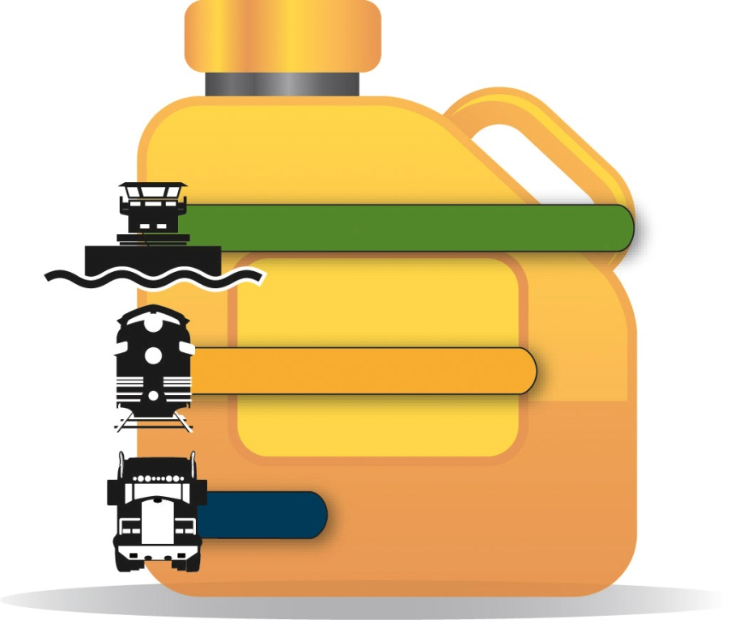
Advantages of Inland Waterways Transport:
Moving Freight Efficiently Throughout America
Transporting freight by water is also the most energy-efficient choice.
Barges can move one ton of cargo 647 miles per gallon of fuel. A rail car would move the same ton of cargo 477 miles, and a truck only 145 miles.
647
477
145
Ton-miles Traveled per Gallon of Fuel
Notes:
Today’s towboat can transport one ton of freight 616 miles per gallon of fuel. A modern locomotive would move that same ton of freight 478 miles per gallon of fuel, and a truck would move it 150 miles. That means barges have an energy efficiency more than 4 times that of trucks.

Slide 18
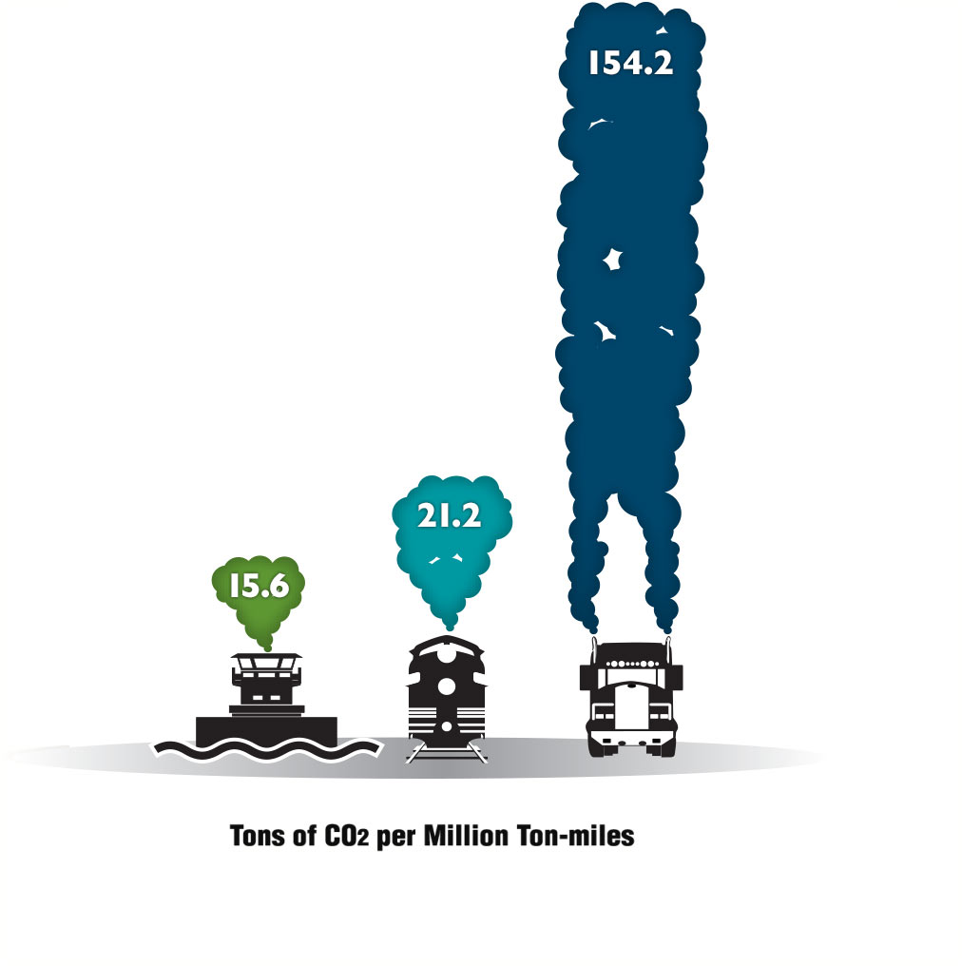
Advantages of Inland Waterways Transport:
The Greener Way to Move America’s Cargoes
Barges have the smallest carbon footprint among other transportation modes.
To move an identical amount of cargo by rail generates 30% more carbon dioxide than by barge, and 10 times more emissions by trucks than by barge.
Notes:
This graphic speaks for itself—inland waterways transportation is the Greener Way to move America’s building-block commodities.

Slide 19
ACF Conclusions and Recommendation
Full potential for over 3.33 million tons of cargo annually to Gulf ports
A $136 million repair investment yields over 29,400 jobs and $1.9 billion in total economic output over 10 years.⁴
Florida environmental representatives need to be a part of the conversation as to whether dredging is needed and how dredging might be accomplished
Shallow draft vessels are part of the solution
The ACF is a crucial infrastructure asset to the nation and should be adequately maintained for ecological concerns, health and safety of downstream residences, industrial users, water supply, recreation, and commercial navigation
References:
Fuller, Wynne, 2016, Feb 18, Presentation, Chief of Operations Division, Mobile District, US Army Corps of Engineers.
Mixon, Phillip PhD., Associate Prof of Economics, 2020, January 7, Economic Impact of the Mid/Lower Apalachicola-Chattahoochee-Flint Waterway.
Clayton, Philip JD, LLM, 2020, Aug 20, ACF Customer Utilization Survey, unpublished, Eufaula Barbour Co. Chamber of Commerce.
Deravi, M. Keivan, PhD. Economic Research Services, Inc., August 2021, The Economic Impact of Restoration of Infrastructure on the Lower Apalachicola-Chattahoochee-Flint River Basin.
Prepared by:
Philip W. Clayton, JD, LLM
Colonel (Ret.)
pclayton@eufaulachamber.com
334-695-3433

